Slide 1
Enterprise Architecture
Dataset Specification Management Process
Helen.lambert@hse.ie Compliance, Assurance & Information Governance Lead
Enterprise Architecture, OoCIO

Slide 2
Dataset Specification Management Process
Recap
The Dataset Specification Management Process
Standardised
Quality assurance
Early input from downstream functions
Reduction in re-work
Islands of information
Apples & Oranges
Compliance

Slide 3
How the DSMP works … Step by Step
Step 3
You talk all the SME’s through your dataset.
They agree to work with you if needed
Step 1
Contact Helen.lambert@hse.ie and she will assist you fill out the DSMP Form
Initiate
Dataset Specification Con-Call
SME Engagement
Dataset Specification Standardisation & Approval
Step 4
SME’s work with you on your dataset
Compliance & Audit
Step 5
Dataset finished.
Your governance group approve it.
Step 2
I organise the SME Con Call and send info about your dataset spec to al the SME’s

Slide 4
DSMP Datasets
DSMP - Progressing Datasets
DSMP No | Initial Contact Date | Dataset Spec Name | Data Requestor / Contact | Concall Date
Pilot | 07/05/2019 | NEWS Chart | Miriam Bell / Avilene Casey | 10/05/2019
000001 | 28/08/2019 | National Standard on information requirements for a National Electronic Patient Summary | Kevin O’Carroll | 10/09/2019
000002 | 20/09/2019 | Gynae Healthlink Discharge Summary Data Set MN-CMS | Deirdre O'Regan | 22/11/2019
000003 | 18/11/2019 | MECC Dataset (Making Every Contact Count) | Dr. Maria O' Brien | 13/12/2019
000004 | 13/12/2019 | Community Health Schemes Medicine Open Data Project (CHSMODP) | Ivan McConkey | 10/01/2020
000005 | 10/02/2020 | eServices | Louise Cooney | 14/02/2020
000006 | 08/11/2019 | National Safeguarding Dataset (NSD) | Marguerite Clancy / Don Munro | 13/03/2020
000007 | 16/04/2020 | COVID 19 | Theresa Barry | 17/04/2020
000008 | 20/05/2020 | SSW ePatient Flow | Noreen Galvin | 12/06/2020
000009 | 11/03/2020 | Quality Care Metrics | Michelle Donnelly, Deirdre Keown, Michelle Quinne - boss Anne Gallen | 10/07/2020

Slide 5
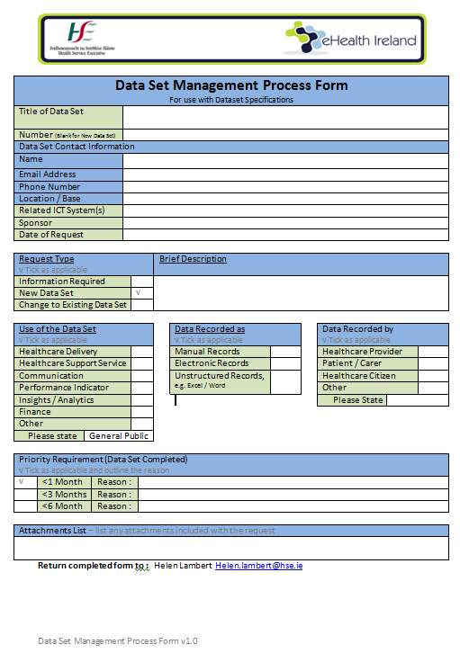
DSMP Form Sample

Slide 6
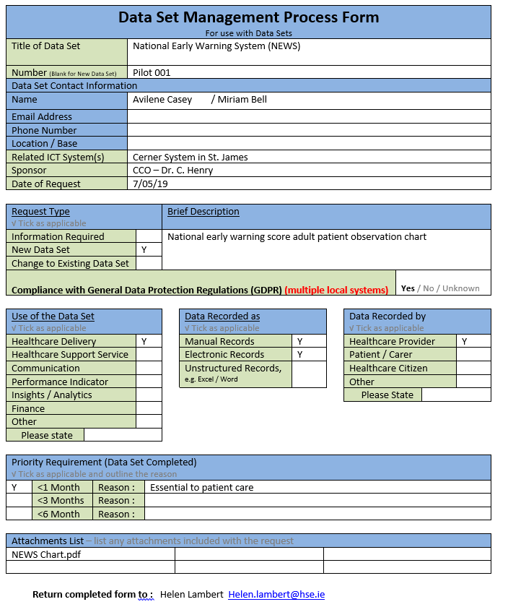
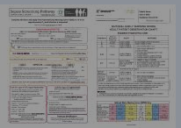
INEWS – our first dataset spec
Step 1
Spoke with Avilene & Miriam and we completed the DSMP Form
Step 2
Contacted the SME’s to set up the con call
Sent out the completed DSMP form & the NEWS
Step 3
Had the SME call, Avilene & Miriam explained about NEWS.
SME’s asked questions
SNOMED SME agreed to work with the NEWS team …..

Slide 7
INEWS

Slide 8
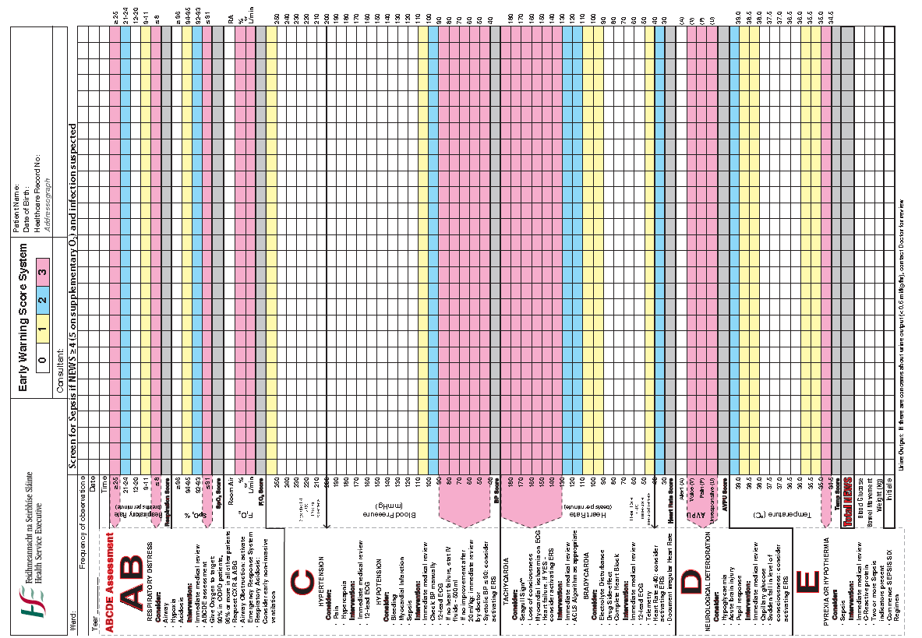
Documentation

Slide 9
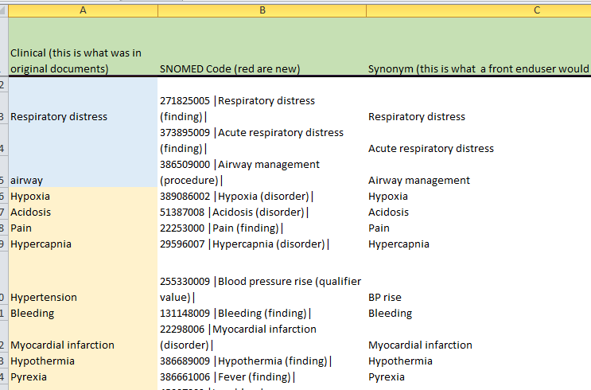
Decomposed dataset

Slide 10
Decomposed Dataset with SNOMED codes
Clinical (this is what was in original documents) | SNOMED Code (red are new) | Synonym (this is what a front enduser would see)
INEWS | 651000220108 |Irish National Early Warning System (procedure)| | INEWS(Irish National Early Warning System)
National Early warning score | 741000220101 |Irish National Early Warning System Score (assessment scale)| | INEWS (Irish National Early Warning) System Score
Minimum Observation | 641000220106 |Monitoring of INEWS physiological observations-respiratory rate oxygen saturation the fraction of inspired oxygen heart rate blood pressure alert confusion voice pain unresponsive scale temperature (regime/therapy)| | Monitoring of INEWS physiological observations-respiratory rate, SpO2, FiO2, HR, BP, ACVPU, temperature

Slide 11
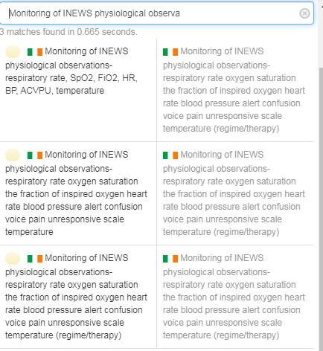
Published content

Slide 12
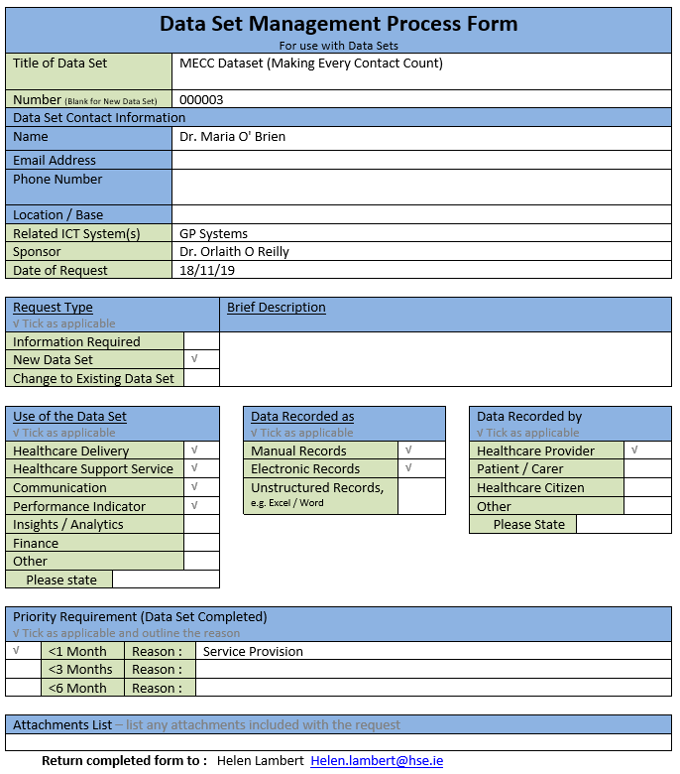
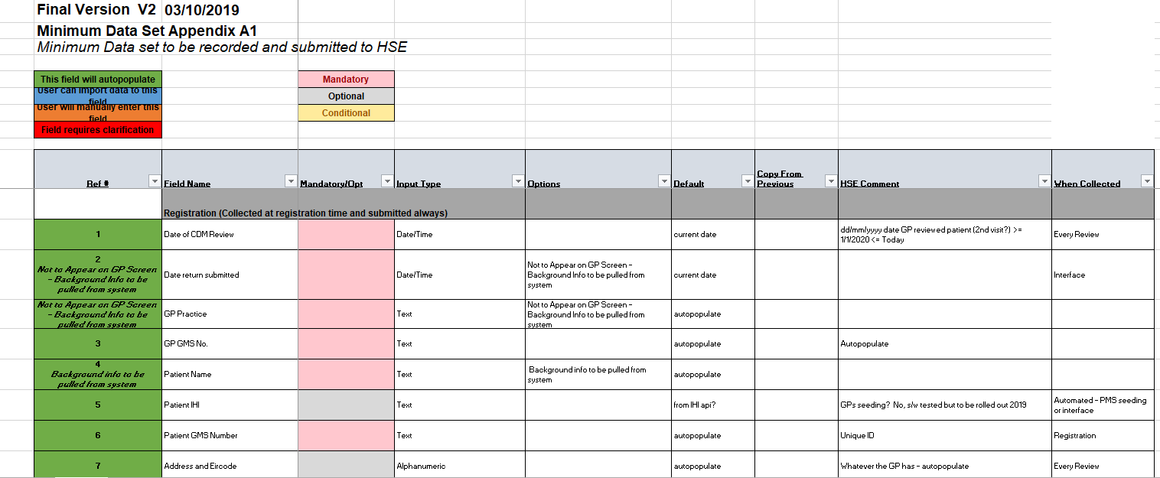
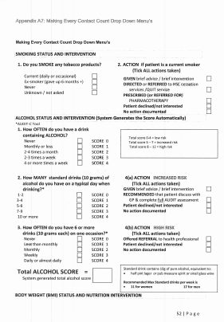
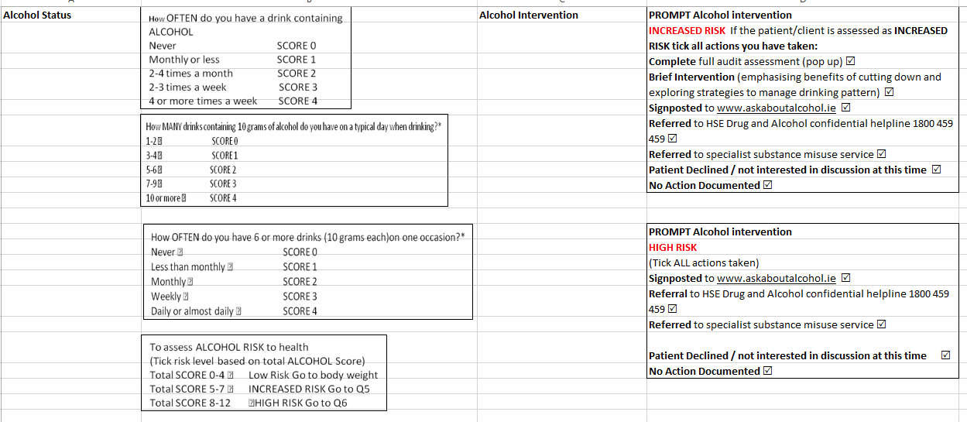
MECC – process more practiced
Step 1
Spoke with Maria and we completed the DSMP Form
Step 2
Contacted the SME’s to set up the con call
Sent out the completed DSMP form & info about the MECC dataset
Step 3
Had the SME call, Maria talked the SME’s through the MECC dataset
SME’s asked questions
SNOMED SME agreed to work with the MECC team …..

Slide 13
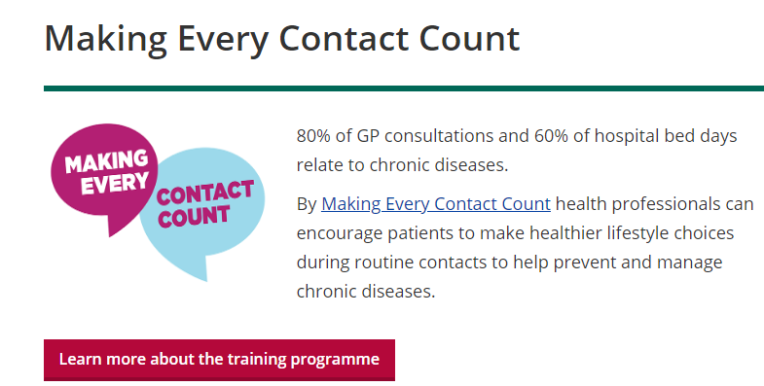
MECC Information

Slide 14
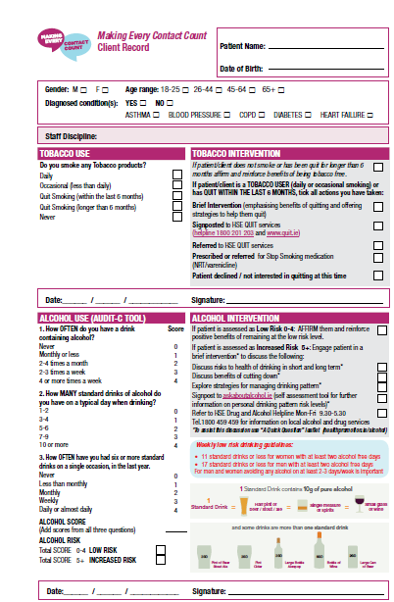
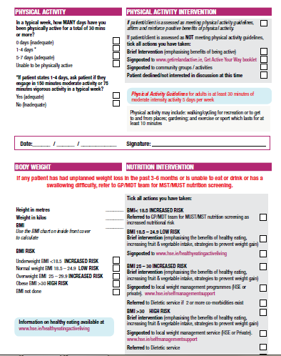

Slide 15
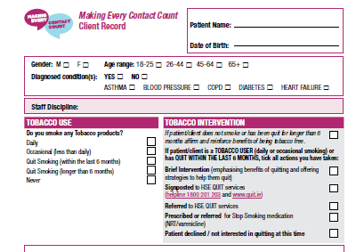

Slide 16
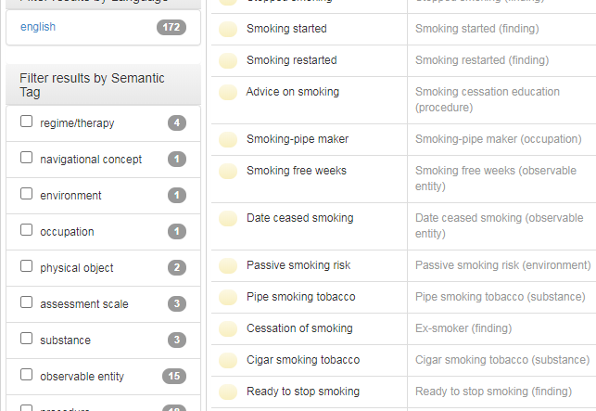
How to transform this into a format for digital use

Slide 17
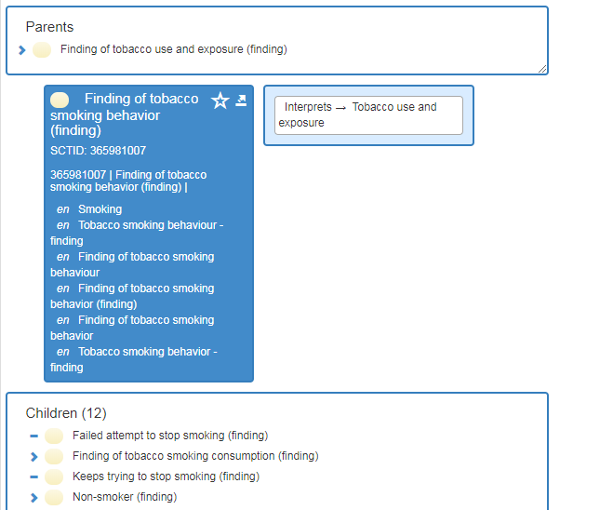

Slide 18
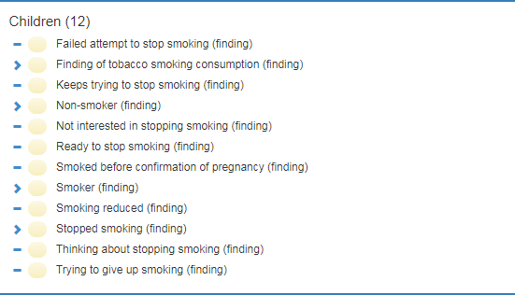
Parent Child relationships

Slide 19
Decomposed dataset with SNOMED
Risk Factors |  | Fully Specifiied Name | Synonym, Endusers view
Smoking status | Smoking status (radio button option) · GPs collect no of cigarettes per day and group later | 66562002 |Cigarette smoking tobacco (substance)| | Cigarette smoking tobacco
 |  | 8517006 |Ex-smoker (finding)| | Ex smoker
 |  | 134406006 |Smoking reduced (finding)| | Smoking reduced
 |  | 84498003 |Pipe smoking tobacco (substance)| | Pipe smoking tobacco
 |  | 26663004 |Cigar smoking tobacco (substance)| | Cigar smoking tobacco
 |  | 394872000 |Ready to stop smoking (finding)| | Ready to stop smoking
 |  | 160617001 |Stopped smoking (finding)| | Stopped smoking
Smoking intervention | Brief intervention (drop down menu) | 771155005 |Brief intervention for smoking cessation (procedure) | Brief intervention for smoking cessation
 |  | | 770729006 |Referral for brief intervention for smoking cessation (procedure) | Referral for brief intervention for smoking cessation
 |  | |719591006 |Varenicline therapy (procedure)| | Varenicline therapy
 |  | 313396002 |Nicotine replacement therapy (situation)| | Nicotine replacement therapy

Slide 20
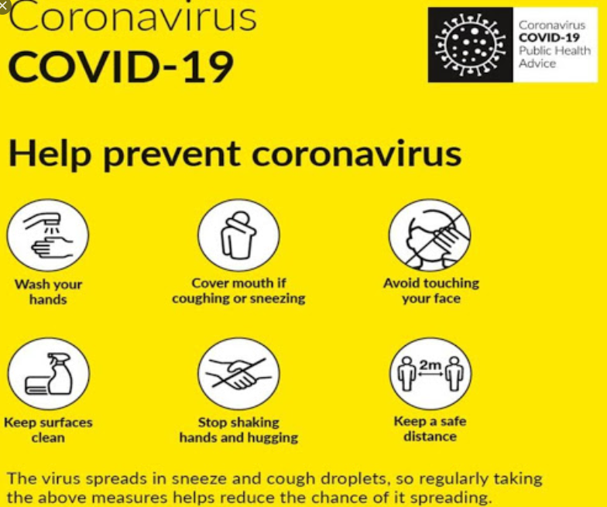
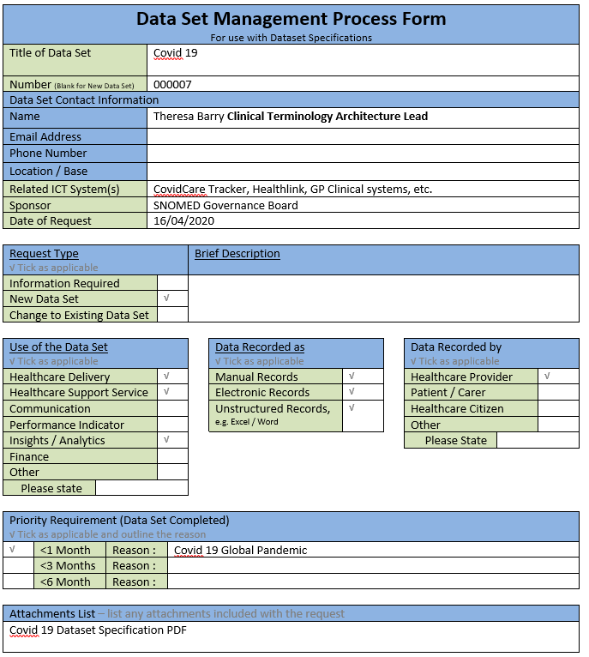
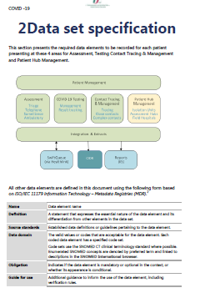
COVID – emergency
Step 1
Theresa called an emergency SNOME Gov Board meeting to approve this dataset on Wed 16th April 2020 and completed the DSMP form
Step 2
Contacted the SME’s on Wed afternoon to set up the con call for 6.30pm on Thur
Sent out the completed DSMP form & info about the COVID dataset
Step 3
Had the SME call, Theresa talked the SME’s through the COVID dataset
SME’s asked questions …..

Slide 21
COVID-19 Dataset
Early April Conf call with Member Forum representatives
Discussion on COVID and the relevant data being collected
Different approaches, collaboration was commenced and within 2 weeks a amalgamated dataset was made available

Slide 22
COVID-19 Dataset
This document has been produced in direct response to the COVID-19 pandemic. The dataset specification is designed to ensure that all patient assessments for COVID-19 are consistently and completely recorded to enable properly informed health service response, tracing, tracking, surveillance and analytics.

Slide 23
COVID-19 Dataset
In Ireland
COVID Tracker, Healthlink, Swiftqueue
Variations of data being collected and recorded
Standardising the data and understanding how to transmit this data, to be available consistently, was required

Slide 24
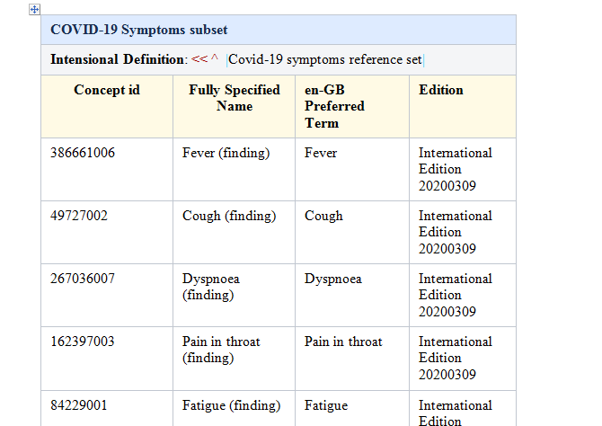
COVID-19 Dataset

Slide 25
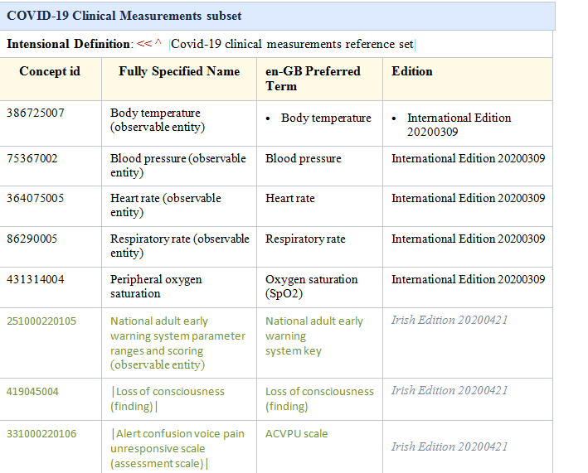

Slide 26
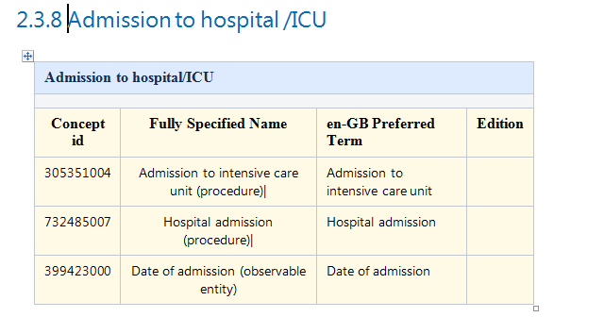
COVID-19 Dataset

Slide 27
Process following development
SNOMED Governance Board
Dataset Specification Management Process
HSE website
For use in COVID Tracker, Healthlink and Swiftqueue

Slide 28
Helen.lambert@hse.ie Compliance, Assurance & Information Governance Lead
Enterprise Architecture, OoCIO

