Slide 1
MS Teams Breakout Rooms
OoCIO Office 365 Team

Slide 2
Meeting toolbar; organiser only

Slide 3
Tips before you start…
Ensure you(organiser) are using the MS Teams Desktop App
Participants can join from any device, but some features may be limited on for e.g. mobile
Only the meeting organiser can create breakout rooms
Up to 50 rooms can be created
In each breakout room, participants can share files, the whiteboard, chat etc. and access them afterwards (in the Teams Chat space)

Slide 4
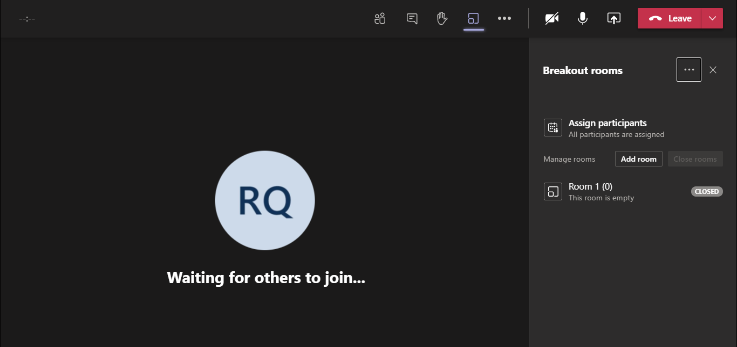
Before the meeting starts; option to add rooms

Slide 5
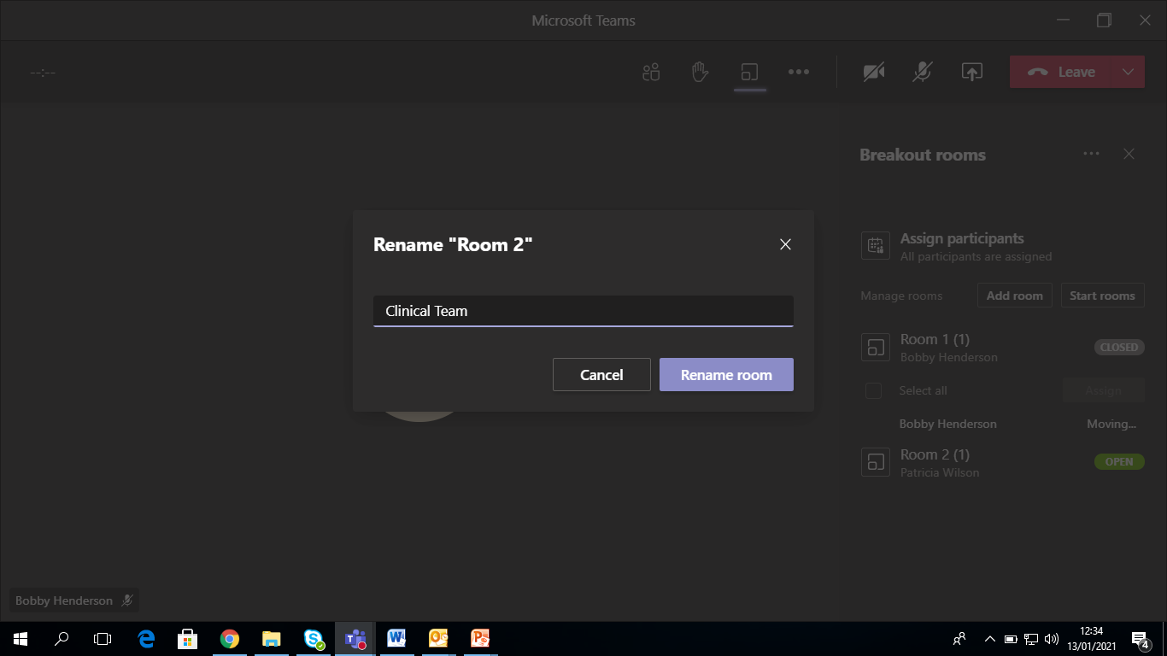
Before/after the meeting starts; option to re-name rooms

Slide 6
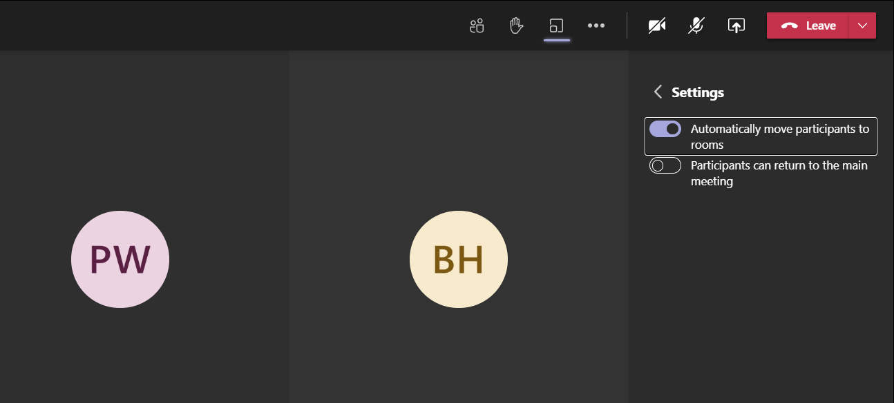
Assign participants automatically or manually

Slide 7
Note: more practical (usually!) not to allow participants to return the main meeting

Slide 8
Ready to send participants to their rooms? ‘Start Rooms’

Slide 9
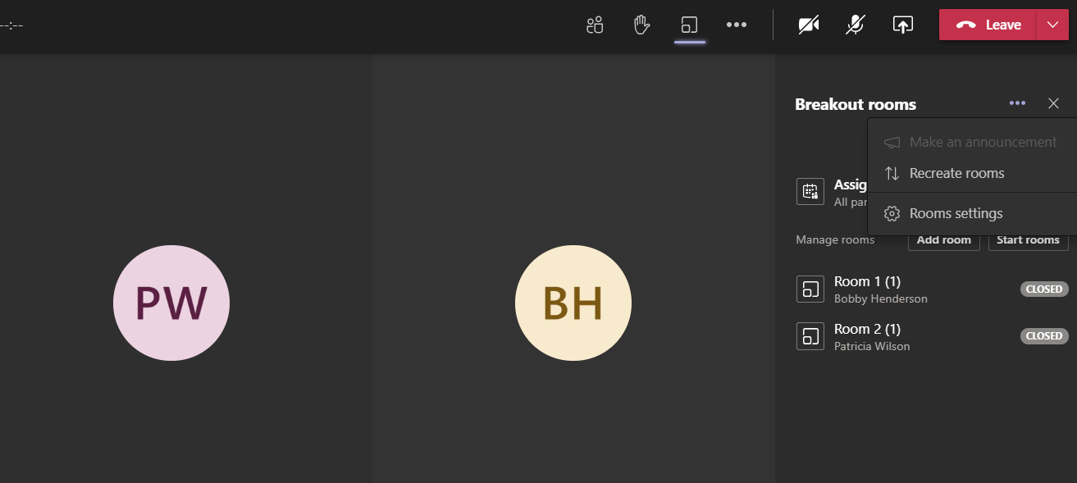
Start again and re-assign all participants? Re-create rooms

Slide 10
Assign a latecomer?
Example: Ann Kozma has joined the meeting late
Everyone else has been assigned to
their rooms (Blue/Red/Green)
Ann will ‘appear’ in the main meeting space when
she enters the meeting
To send her to a room (assign her), go to
‘Participants’ in your toolbar, then select her name.
The list of available rooms will then appear
She can be assigned to the selected room,
without disturbing any other rooms’ participants

Slide 11
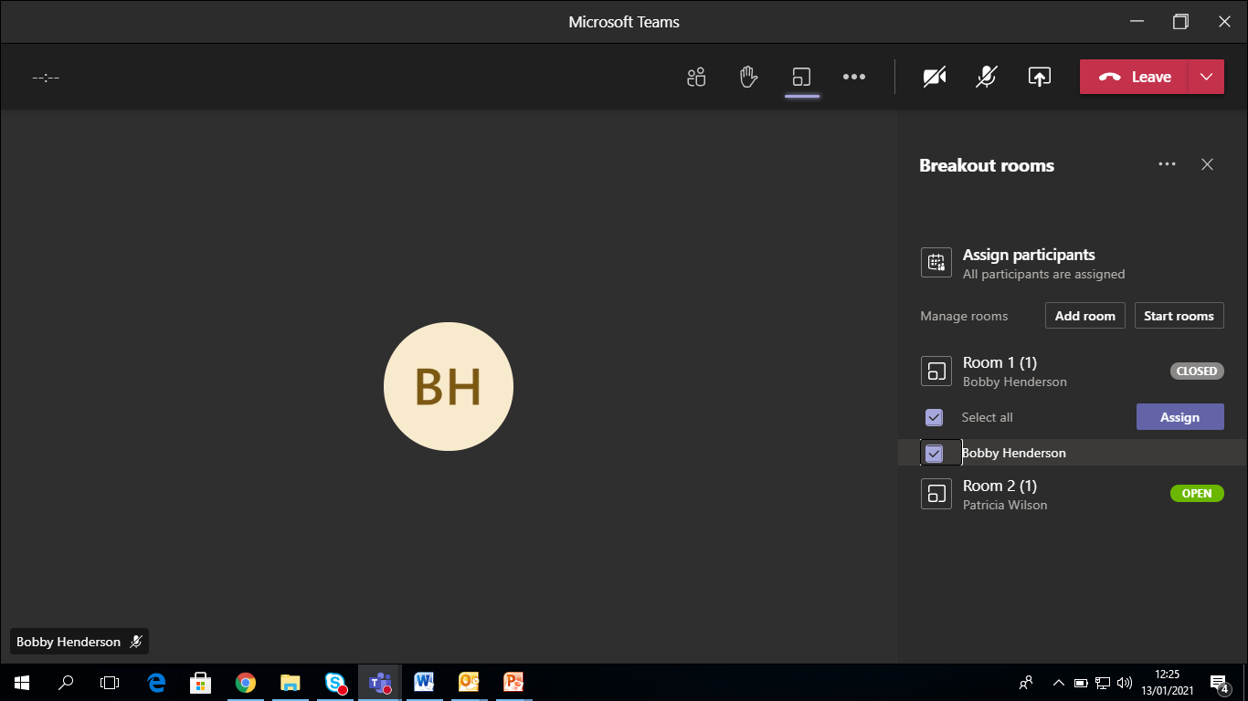
Move one or more attendees to a different room? Close that room only and re-assign

Slide 12
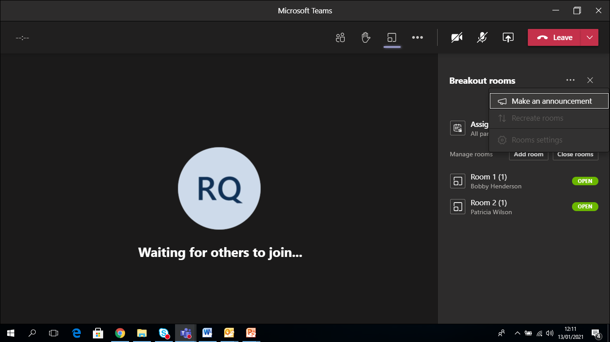
Organiser can communicate with rooms using Settings/‘Make an Announcement’

Slide 13
Create your announcement

Slide 14
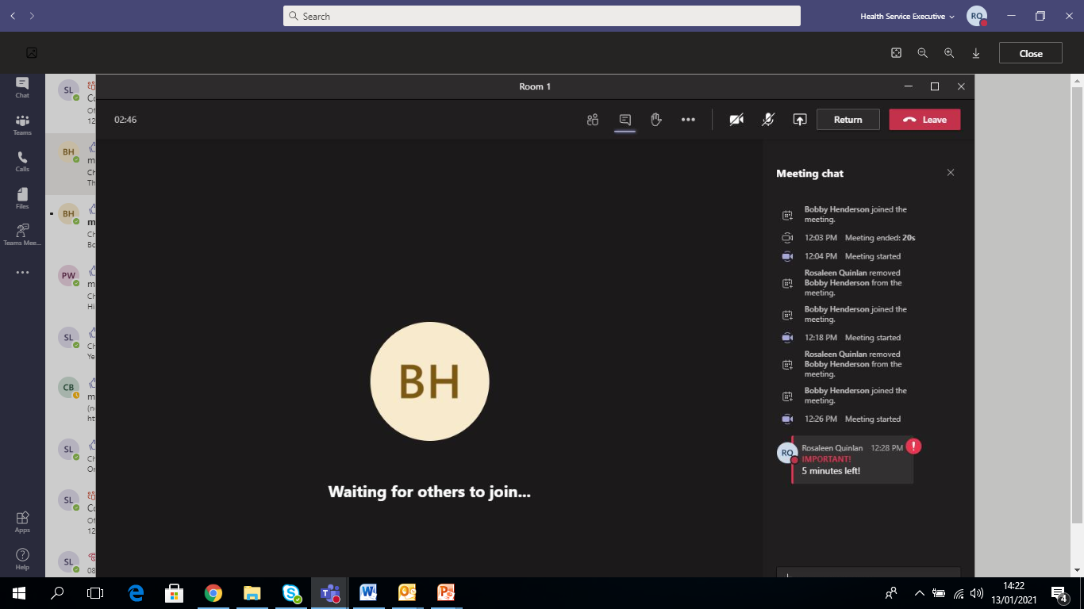
Announcement appears in each room’s individual chat

Slide 15
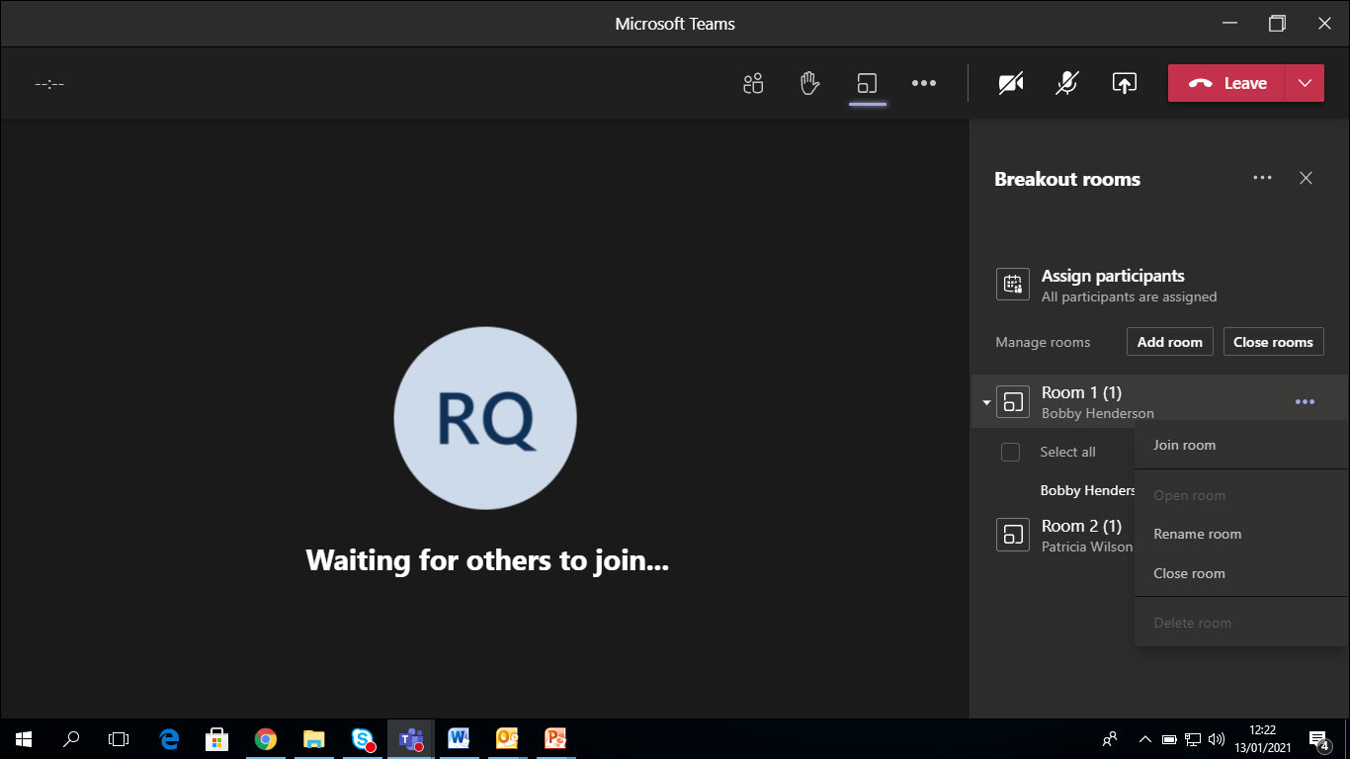
The organiser(only) can also join any room- select the room, then ‘More Options’ and ‘Join Room’

Slide 16
Bring all back to main meeting? ‘Close Rooms’ (all at once) or close individually

Slide 17
Thank You!

