Slide 1
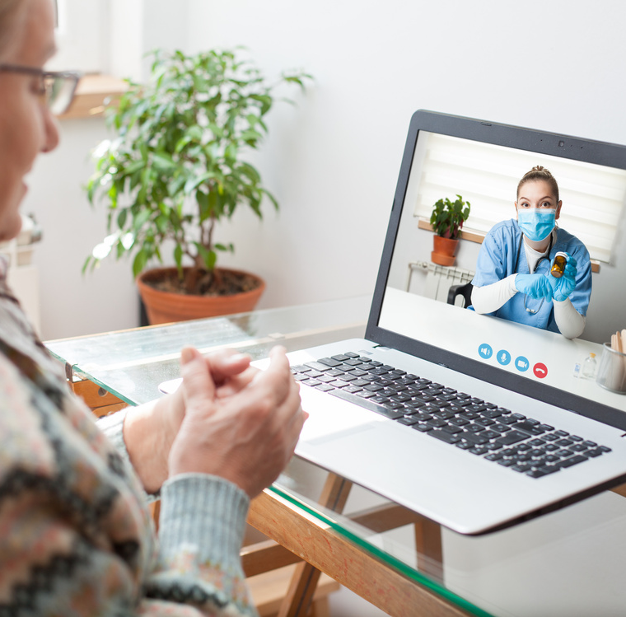
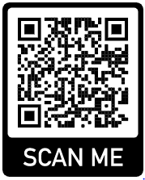
Who is involved?
What happens next?
Health Care Professional
Service User
Relative(s)
Friend(s)
Family members
Your Healthcare Professional will organise a call and schedule a specific time and date.
At the scheduled time and date, your Healthcare Professional will provide you with a technology device and set up the video call.
You will get further help if you need assistance
Include Hospital/Service Name
Patient Information
Virtual Visiting Service
We welcome any comments or suggestions that may help to improve this service
(service contact details below)
Contact your Healthcare Professional
via phone or email
Or
As an inpatient inform a member of
staff in the service
Please be advised that no clinical information will be given out by your Healthcare Professional via the technology device
Patient Page HSE
Contact Us
Include contact details for service

Slide 2
The virtual visiting service enables regular contact with families and friends.
This facilitates a video call from the Service User to a family/Friend/relative at a pre - arranged time
How to access the service?
If you would like to arrange a pre booked video call please follow the steps below:
Contact your Healthcare Professional
Office times are include Day, time
Your family/friend/relative can also make contact via our email service. Send a detailed email to include email address
If you are an in-patient you can ask a member of staff to contact your Healthcare Professional to arrange access to this video service
What are the benefits?
Connects the service user and their families
Helps with loneliness and isolation for the service user
Helps reduce stress and anxiety for both the service user and their family/relative/friend
Creates a positive environment in the facility as the Healthcare Professionals support service users and their families in the best way they can
Reduce the risk of infection
What if I don’t speak English?
If you need an interpreter to translate for you, please let your Health care professional know when we contact you about the video service.
An interpreter can access the video service

