Slide 1
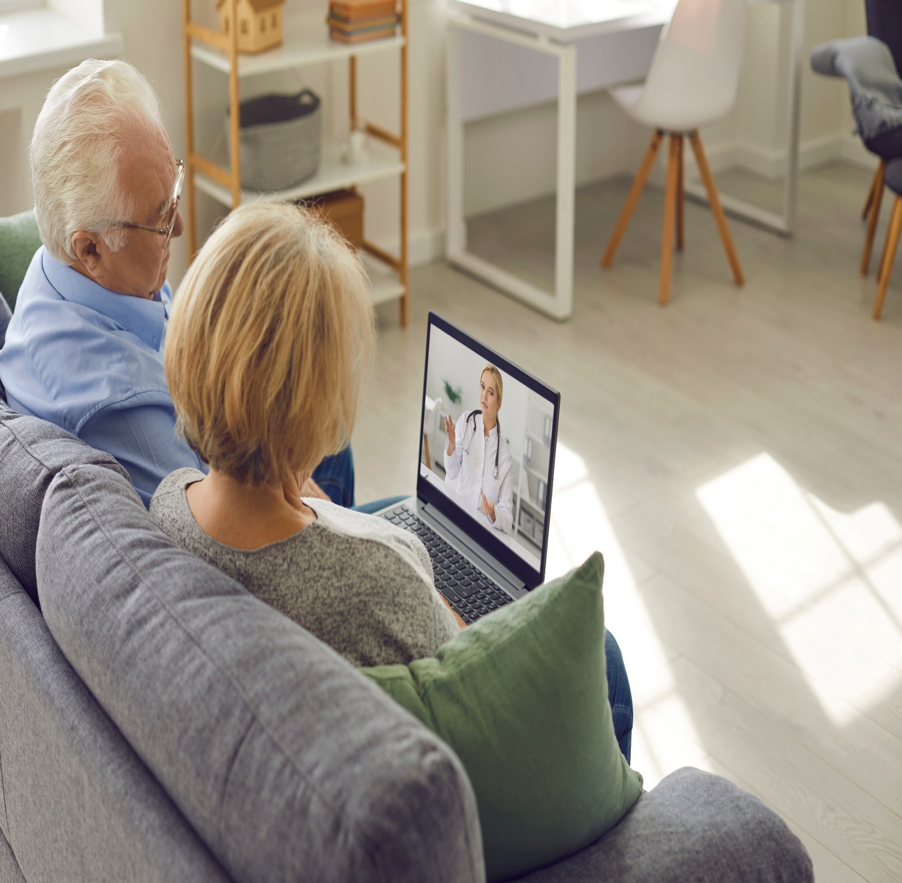
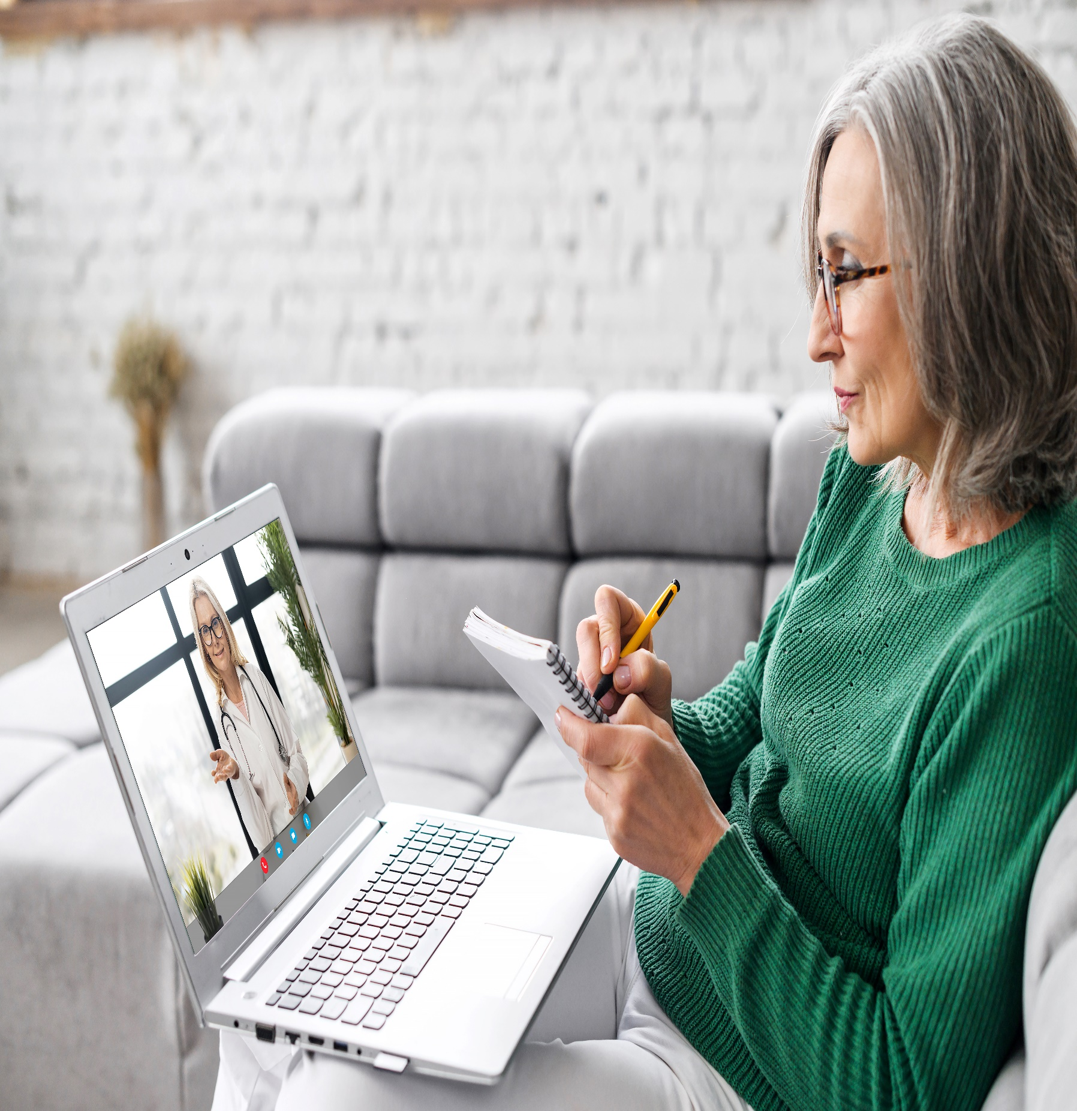
You can talk to our rehab team
about using video consultations
from your home
Online video consultations available for:
Overview of home environment
Family meetings
Family/Carer training
Talk to your rehab professional for more details

