Slide 1

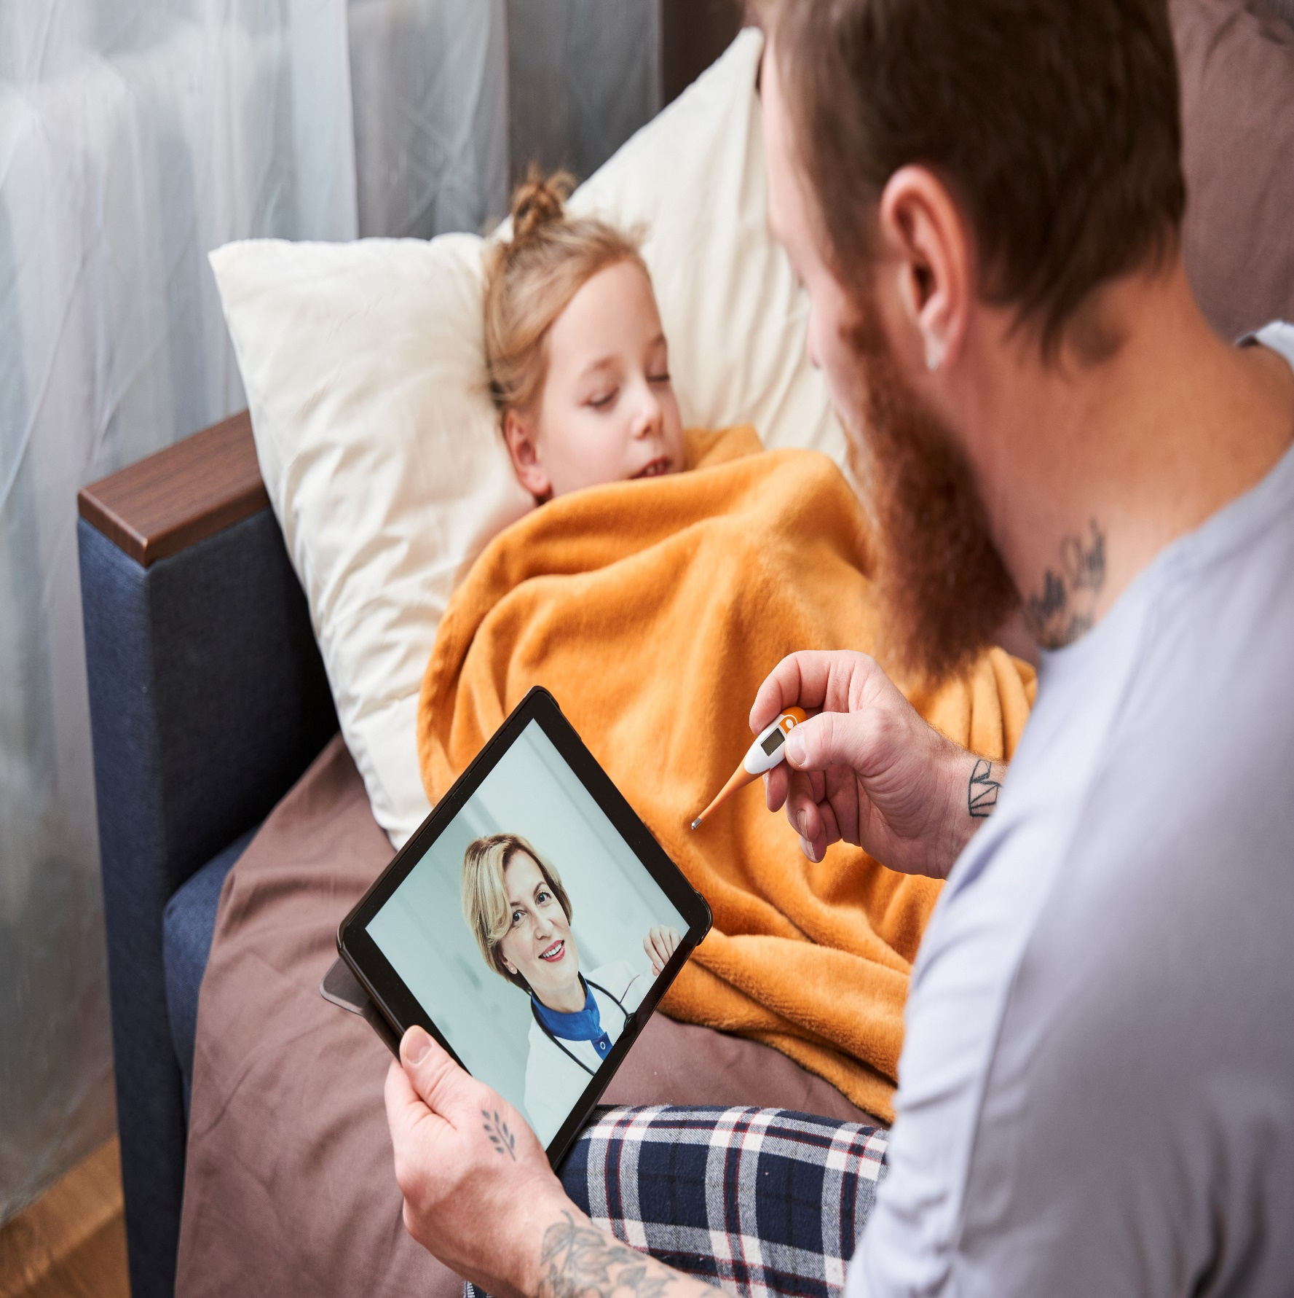


Include your
Logo Here
Online Health Appointments
using video
Talk to your healthcare professional today
about online health appointments
Now
Available
For further information: www2.hse.ie/services/online-health

