Slide 1
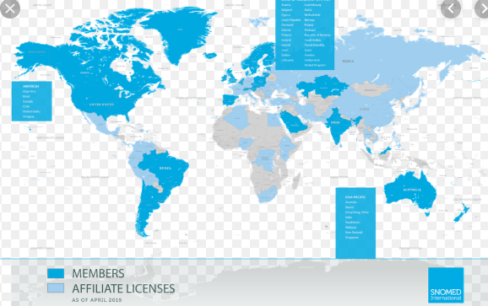
SNOMED CT in Ireland
Being part of an International Community
Theresa.barry@hse.ie
Theresa.barry@hse.ie

Slide 2
ARCHITECTURE DEVELOPMENT & ASSURANCE
EA Vision
Technical Architecture Roadmap
Reference Architectures
Architecture Patterns & Domain Blueprints
Team Skills & Capabilities
Architecture Practices & Education
Architecture Representation – National
Architecture Representation - EU
Architecture Review Session
Regulatory Compliance Support
3rd Party Contract Reviews
IT Security & Standards
OID Registry
Innovation Support
EU National Contact Point
SNOMED CT National Release Center
Key Deliverables
Standards, Policies & Guidelines
Architecture Roadmaps
Architecture Blueprints
Architecture Reference Architectures & Patterns
Architecture Education Programme
Regulatory Compliance Support
Information Security & GDPR Checklists
OID Registry
Notes:
QIP into EA team skills & Capabilities merge

Slide 3

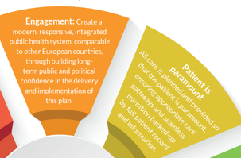
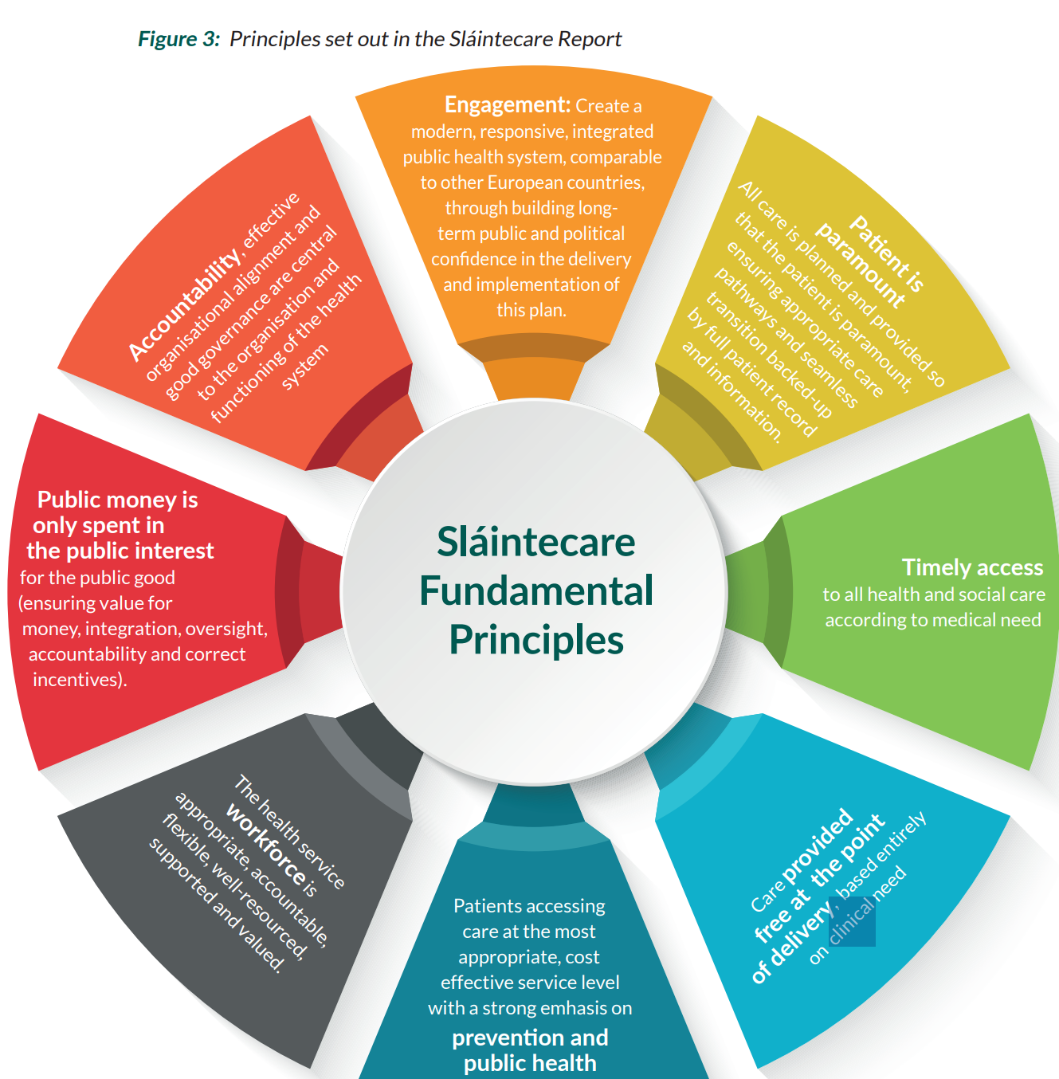
SlainteCare

Slide 4



Healthcare Professionals in the past and current
Patient problems
Treatment
record

Slide 5




Slide 6



The interoperability challenge
Hospitals
General practice
Allied health professions
Pathology
Diagnostic imaging
Specialists
Pharmacists
Ambulance/Emergency services
DIFFERENT DOCUMENTS
DIFFERENT TERMINOLOGY
Patient record
“I have breathing problems sometimes”
“I am an asthmatic”
“I have asthma attacks”
“I am diagnosed with respiratory disease”
DIFFERENT FORMATS
DIFFERENT SYSTEMS

Slide 7


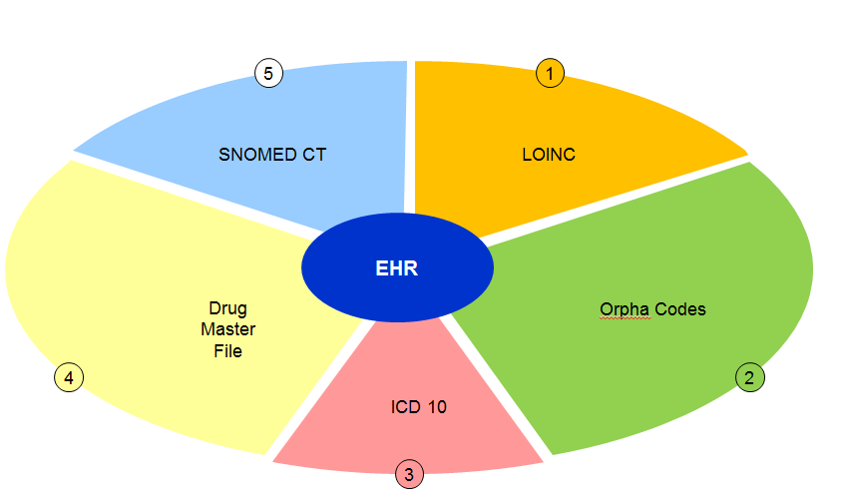
Terminologies/Classifications
ICD 10
 | SNOMED | ICD 10
Type | Terminology System | Classification System
Purpose | Information Input | Information Output
Function | Describes and defines clinical information for primary data purposes | Aggregates and categorises clinical information for secondary data purposes

Slide 8
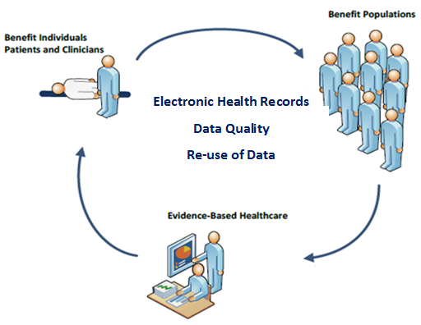
Benefits of SNOMED CT

Slide 9

HIQA Recommendations 2014
1) SNOMED CT should be adopted as a national clinical terminology for Ireland immediately.
2) A SNOMED CT National license should be purchased and the resourcing and functioning of a national release centre for Ireland should commence in 2015.
3) The feasibility of entering into an agreement with a SNOMED CT national release centre in another jurisdiction should be investigated in order to provide support in the short-term (early stages of operation of SNOMED CT in Ireland).
4) SNOMED CT should be introduced gradually on a project-by-project basis with the active support of the SNOMED CT National Release Centre.
5) In order to future proof information communication technology (ICT) investment, the requirement to support SNOMED CT should be included in all relevant software procurements from now on.
6) A review should be undertaken to determine the most appropriate agency to establish and operate the SNOMED CT National Release Centre

Slide 10
What is SNOMED?
SNOMED CT is a terminological resource that can be implemented in software applications to represent clinically relevant information reliably and reproducibly thus
  providing standardised way to represent clinical information
  improving our ability to code, retrieve, and analyse clinical data
SNOMED CT
  the most comprehensive clinical terminology available internationally
  organised in 19 hierarchies such as diseases, symptoms, procedures
  composed of concepts, descriptions and relationships
  extensive
  - 293,000 concepts
  - 765,000 descriptions
  - 830,000 relationships

Slide 11

Establishing the NRC is similar to establishing a franchise
“knowledge, processes, and trademarks”
    Irish NRC

Slide 12
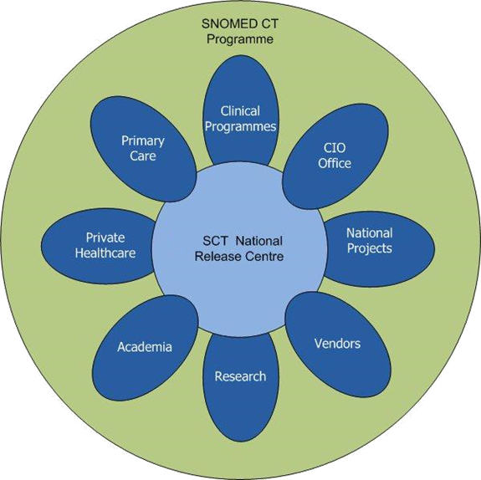
Engagements to date
CCIO and CIO Nursing, Clinical leads all HSE domains and commence Masterclasses
Office of CIO is the delivery channel for SNOMED CT
Chronic Disease Management
AFIS, CDM, EHR, MN-CMS,NRH,CHI/ DSMP
Vendor specification document and developers day July 2020
Presentations given in UCC, UL and HISI, clinical forum with CCIO.
Rights
Obligations
Learning
Set up NRC
Managing distribution of SNOMED

Slide 13
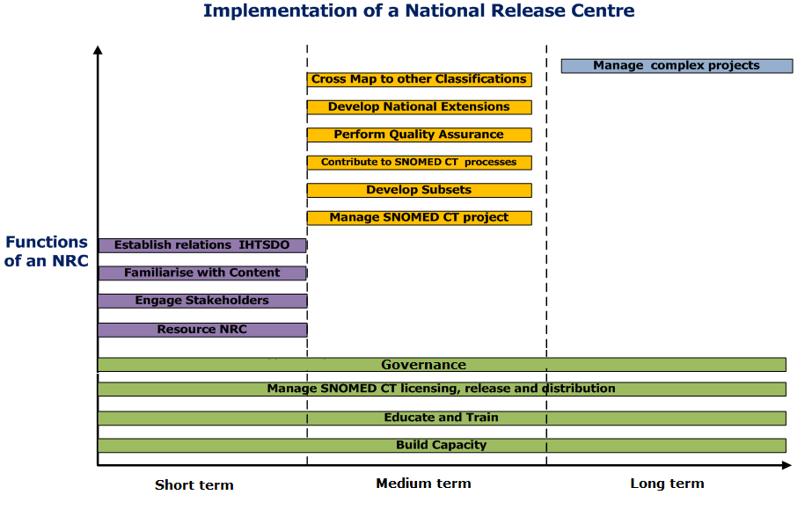

Slide 14
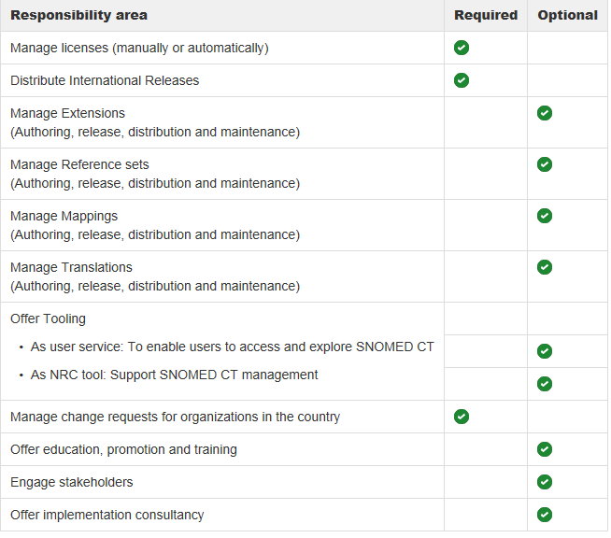
Required and Optional role of NRC

Slide 15
General Assembly –is the highest authority in SNOMED International and contains one representative from each member country
They can make binding decisions on budgets, work plans and strategic goals
Twice yearly face to face meetings
Member Forum rep-acts as an advisory body to the Management board and facilitates point of contact for all stakeholders
Optimizes the collaboration and coordination among member countries
Facilitates contact and communication between countries with similar foundations/needs
Can raise issues of concern to management board
Key player in which work items should be priortized
Twice yearly face to face meetings

Slide 16



Strategic deployment
Vision
The SNOMED International objective is to enable users of SNOMED CT is to facilitate the accurate recording and sharing of clinical and related health information and the semantic interoperability of electronic health records.
Scope
A National Release Center (NRC) has the responsibility to serve as the interface between SNOMED International, the national users and Affiliates, and other Members.
Strategic Direction
Introduction
Deployment
Compliance
Tactical Plan
Presentations
Define process of engagement
Governance
Conferences
Managed Service
Training and education (end users)
Social Media
Policies and procedures
Quality assurance
Workshops
Training of resources
Integration
CCIO
Communications
EA
PMO
NCP
DD
SNOMED International
HIQA
DOH

Slide 17
What do we need to do to use SNOMED?
Strategies
Governance
Early adopters
/people
Interoperability
HI Standards
.
.
.

Slide 18
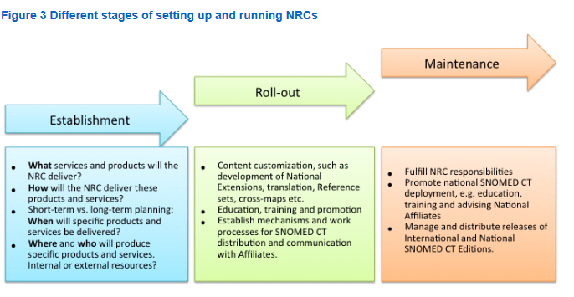

Slide 19
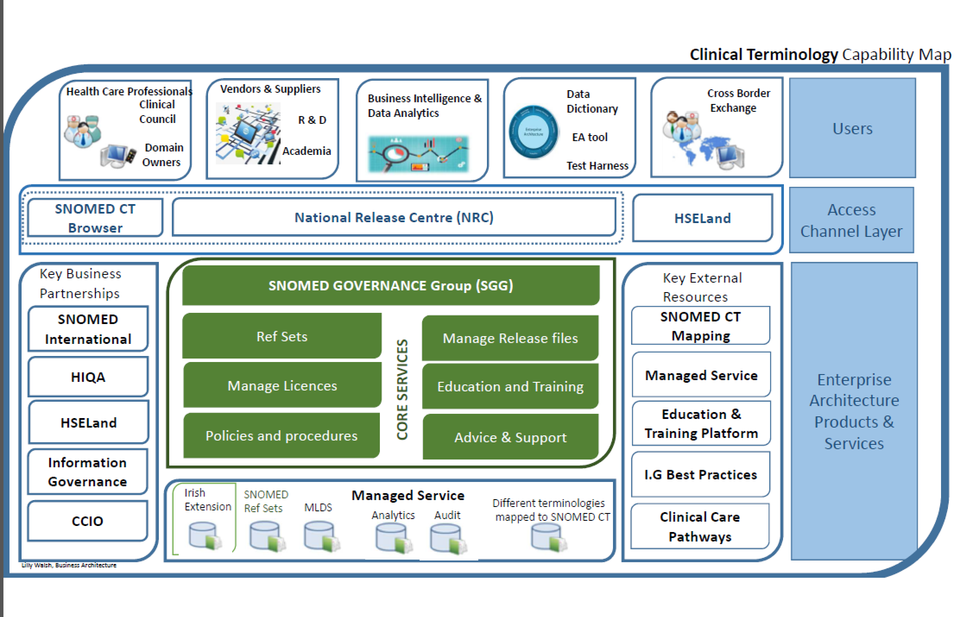
Capability Map

Slide 20
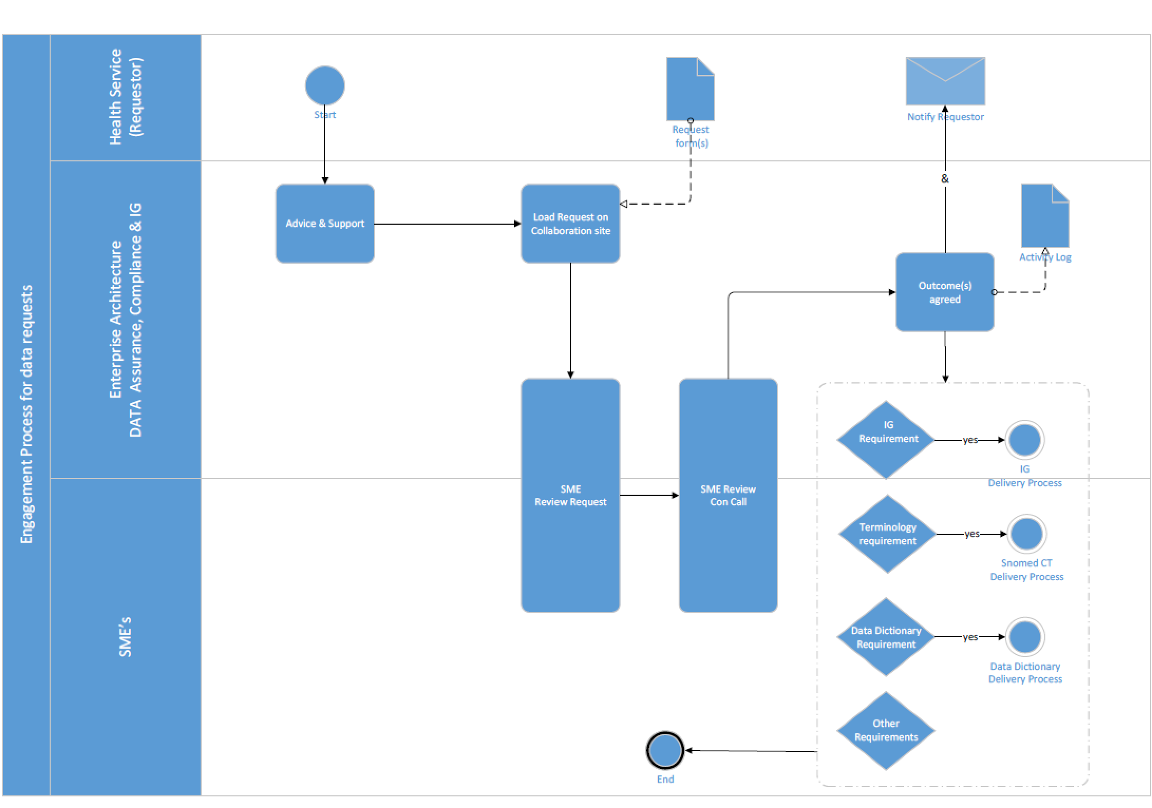
Data set management specification

Slide 21
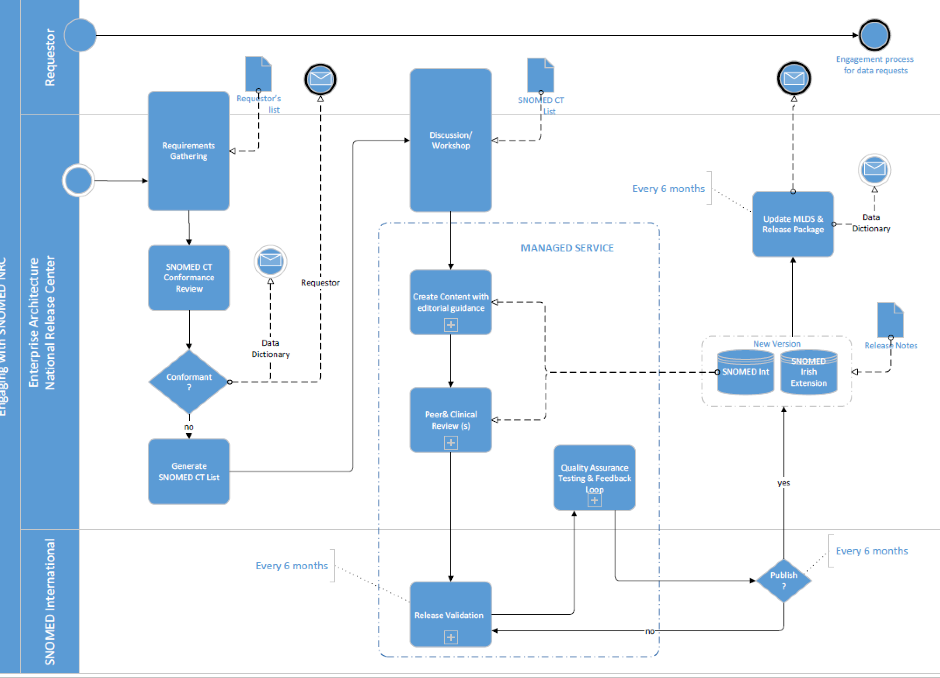
Data set management specification

Slide 22
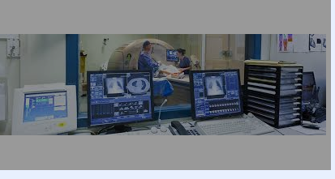
Clinicans role /Office of CIO role
Having all our healthcare information on computers will improve everything?
Ensure Vendor specification document included in all clinical system procurements
Ensure clinicans are aware of requirement to engage with NRC
SNOMED CT is the clinical terminology that will record, retrieve, and help us to analyse our patient information for better patient outcomes
This needs to be configured for our systems with our clinical leads deciding what clinical terms are in our systems

Slide 23
Vendors/Suppliers role in distributing SNOMED CT in Ireland
Vendor specification Document 2018, included in all procurements
Training and education for suppliers-how to manage SNOMED CT in applications/systems
E-learning available

Slide 24
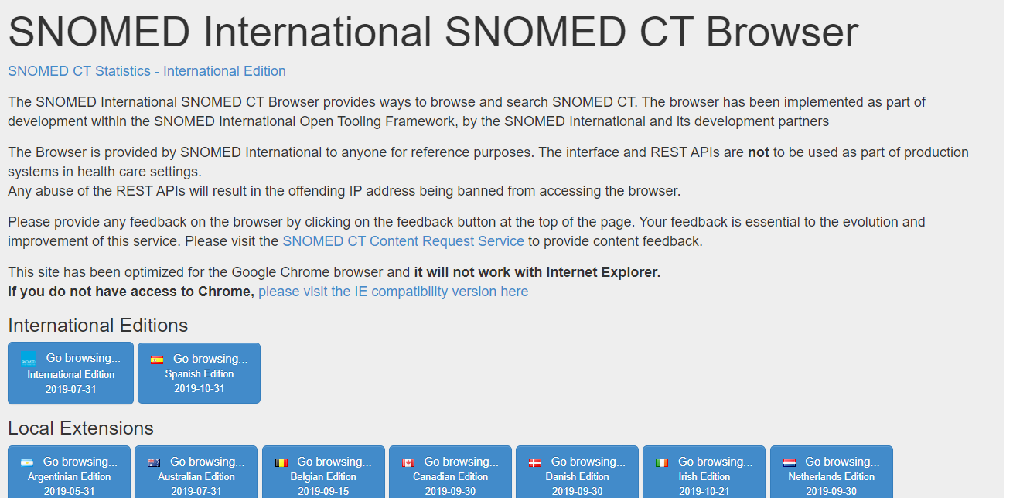


Slide 25
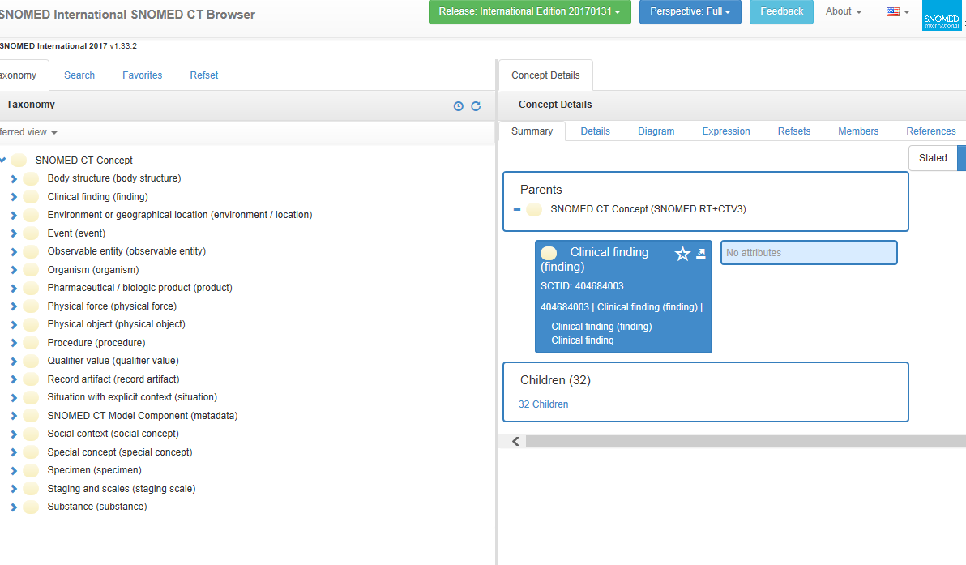

Slide 26
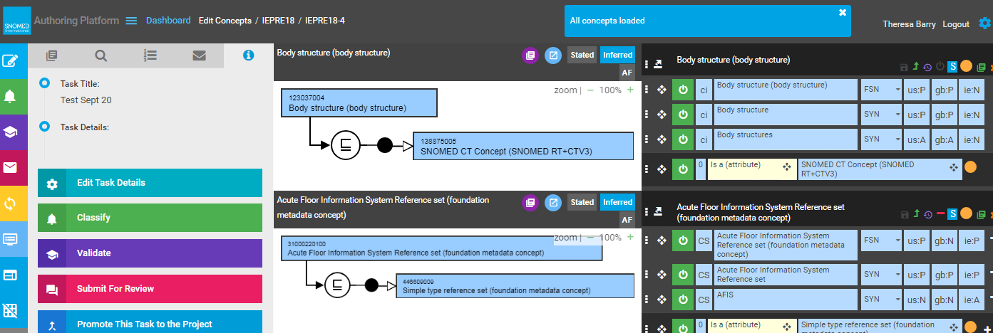
Managed service
3rd release April 2020

Slide 27
Advisory groups
Role of an advisory group
SNOMED International has seven Advisory Groups (AGs) that conduct specific activities that contribute to the fulfillment of the Management Team’s responsibilities and the organization’s mandate.
The Advisory Groups are chaired by Management Team members and are agile in nature, given the changing needs and direction of the organization.
At the beginning of each year, each Advisory Group develops a group work plan outline, determines whether Task and Finish sub-groups are required, outlines any resource requirements, and lays out a set of criteria in order to measure the progress of the applicable group work plan.
Content Managers advisory groups
E-Learning Advisory groups
Terminology Release Advisory Group
Modeling Advisory Group
Editorial Advisory Group
Software Development Advisory Group
Tooling Advisory Group

Slide 28
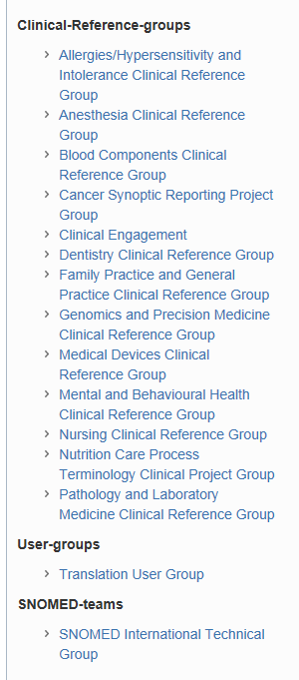
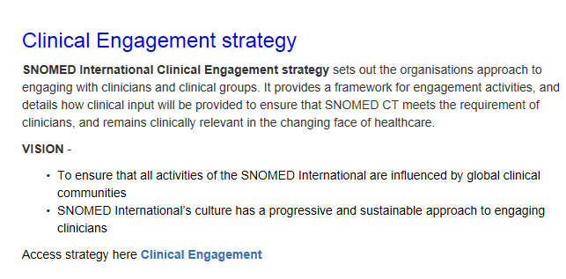
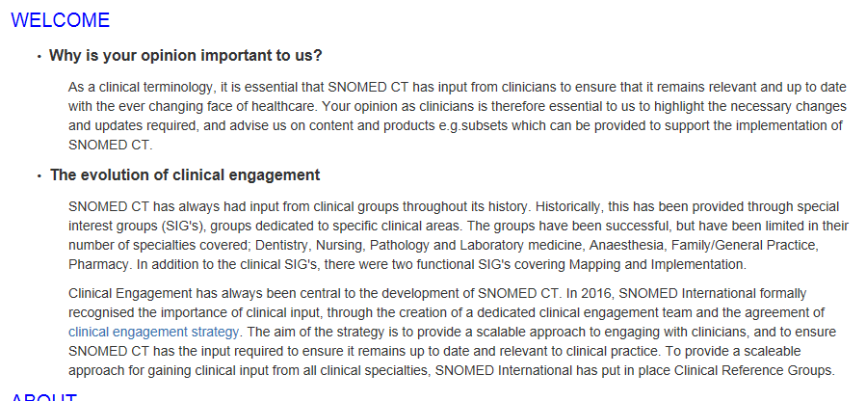
CRG’s

Slide 29
Analytics
SNOMED CT concepts are modelled in such a way that their meaning can be represented using a formal family of logics called
Description Logic (DL). Description logic enables computers to make inferences about the concepts in SNOMED CT and their meanings,and to classify SNOMED CT using a DL reasoner. Description logic also allows the formal computation of:
Subsumption – Testing pairs of expressions to see whether one is a subtype of the other
Equivalence – Testing pairs of expressions to see whether they have the same logic-based meaning
Subsumption and equivalence are both extremely useful functions when retrieving or querying clinical information. For example, when retrieving all clinical records related to 73211009 |diabetes mellitus|, it would usually be necessary to retrieve records referring to any subtype of this concept, such as 23045005 insulin dependent diabetes mellitus type 1A

Slide 30
SNOMED CT Course Catalogue E Learning
The SNOMED CT Course Catalogue offers education courses and certification exams for beginners through to advanced users of SNOMED CT.

Slide 31
Next steps
Key stakeholders
PMO, Vendor engagement document circulated and available
Vendor developers day July 15th 2020
Clinicians', Clinical Forum engagement and Master classes via webinar
Clinicians to configure datasets to create ref sets to import into solutions

Slide 32
Useful Links
Useful links
Email NRC@hse.ie Theresa.barry@hse.ie
Website http://www.snomed.org/
Apply for an affiliate licence
https://mlds.ihtsdotools.org/#/landing/IE?lang=en
Education and learning
Log in to www.hseland.ie (if you are a first time user select 'create an account')
Select 'Hubs' from the homepage
Enter the 'Share Centre'
Select 'SNOMED-CT' from the list of Projects and Resources
SNOMED CT Browser
https://browser.ihtsdotools.org/?

Slide 33



Email. NRC@hse.ie
Theresa.barry@hse.ie

