Slide 1


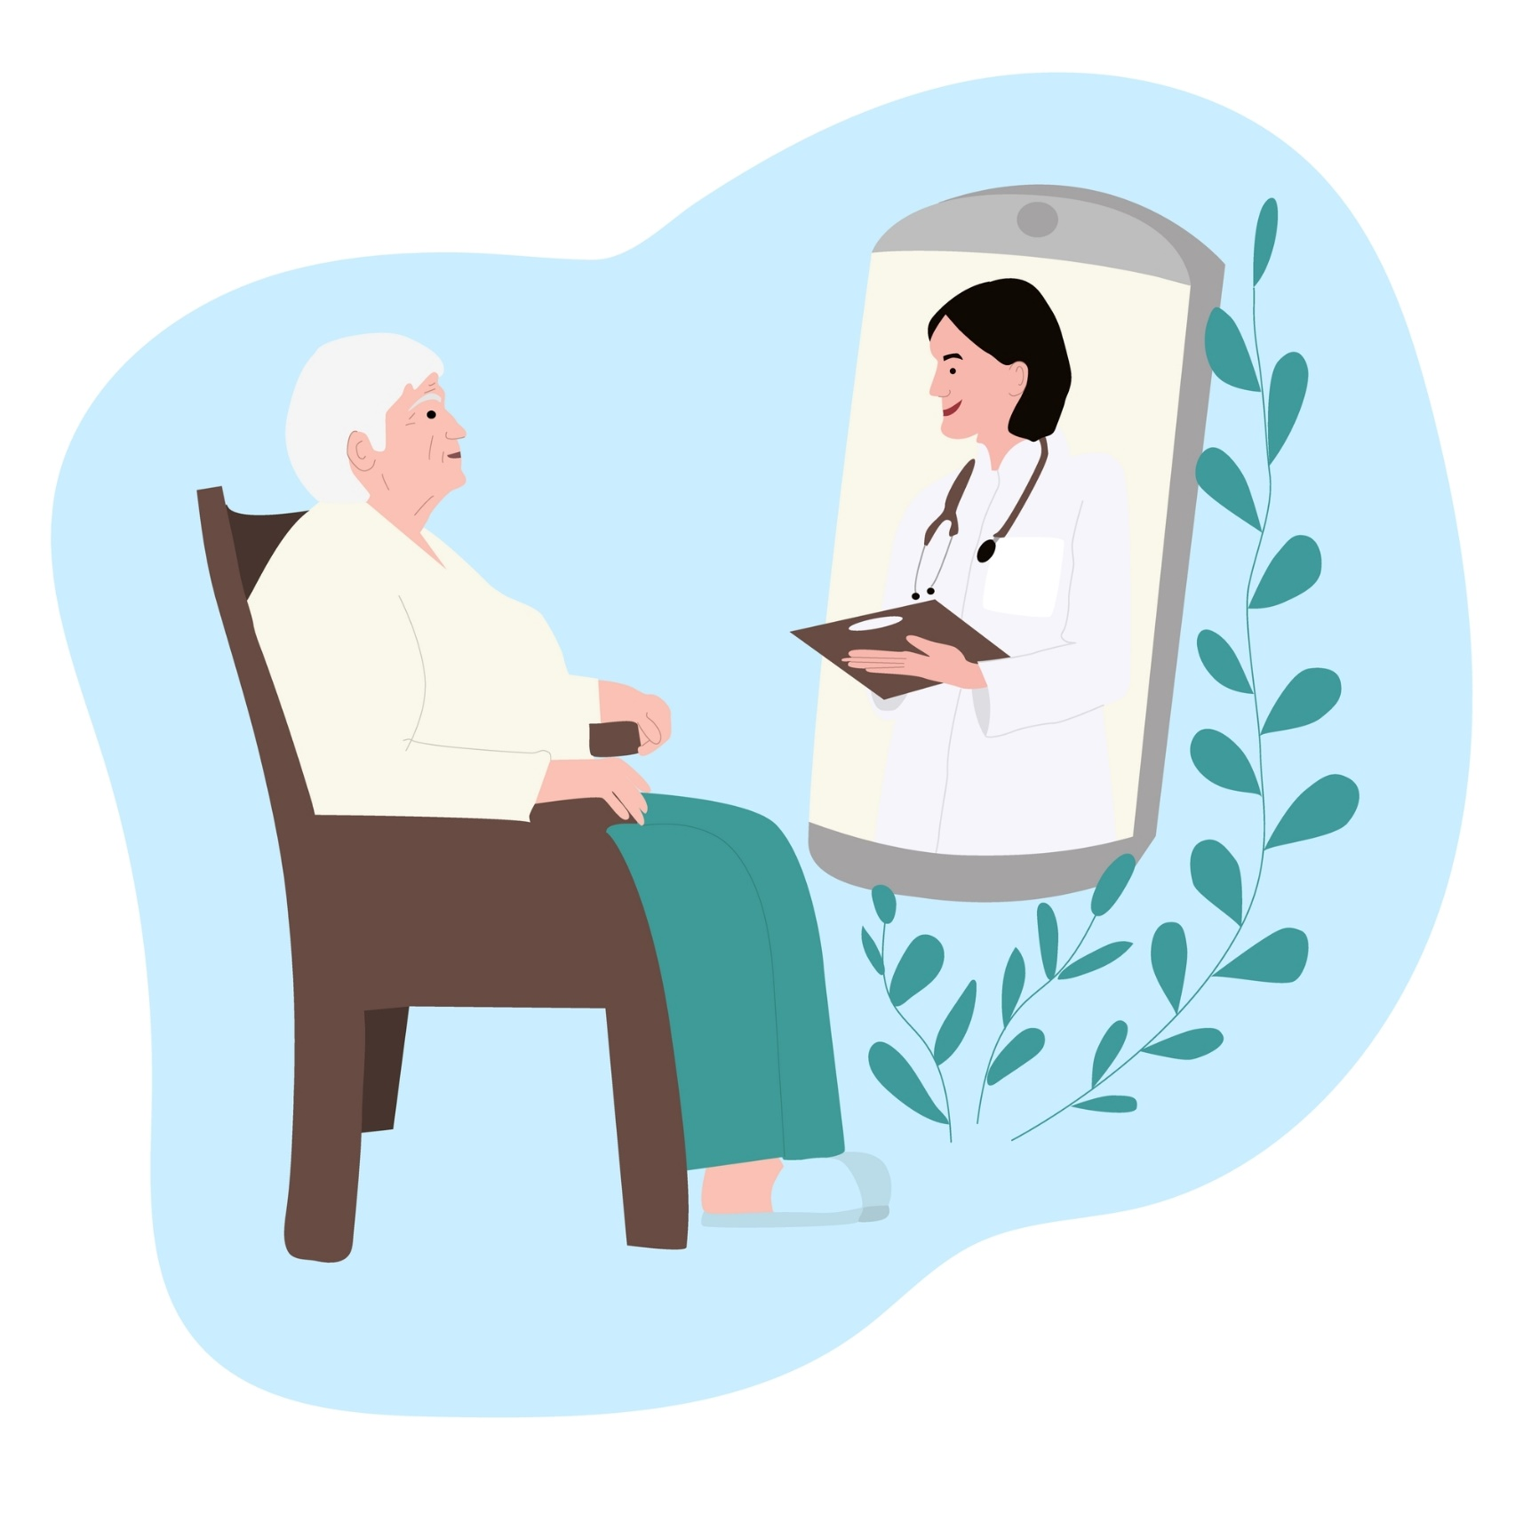
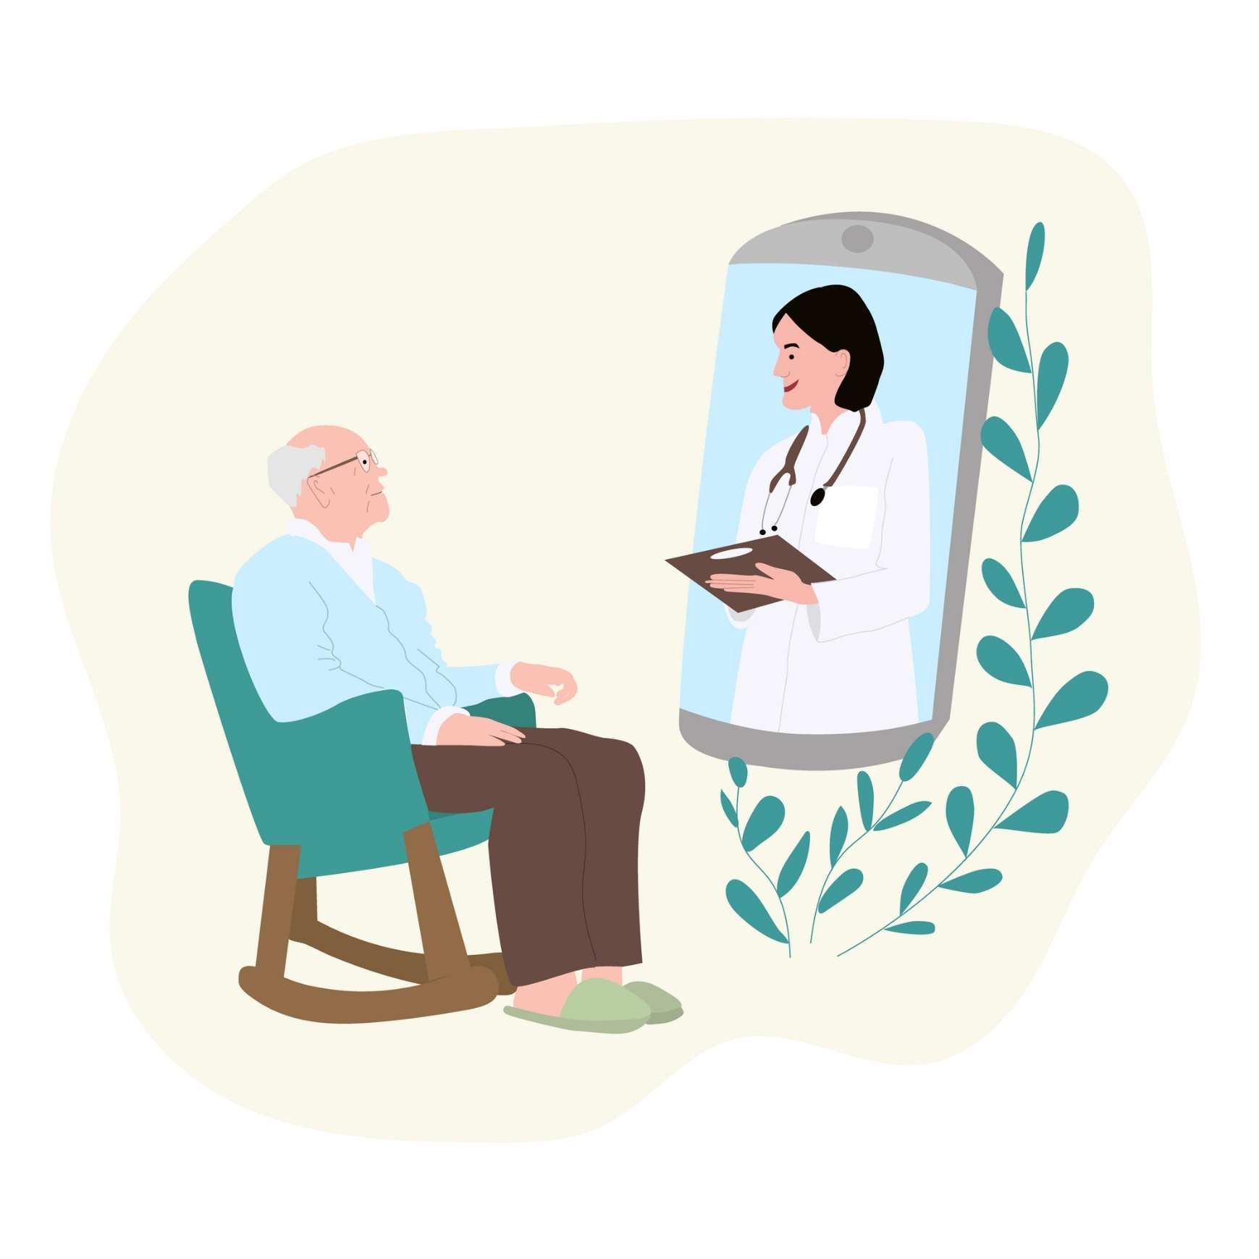


Online Health Appointments
using video
Talk to your healthcare professional today
about online health appointments
Your next appointment
may be arranged from
the comfort of your own home.
Please speck with any of
our team today.
For further information: www2.hse.ie/services/online-health

