Slide 1
Storm Éowyn NCMT Briefing 22/01/25
Bottom Line Up Front:
Message from NECG Meeting
22/01/2025
This Is a generational storm that will see largescale damage – the general safety message to be issued is
“everybody is to shelter in place” this may be applied to emergency services, rescue and recovery crews except in extraordinary circumstances

Slide 2
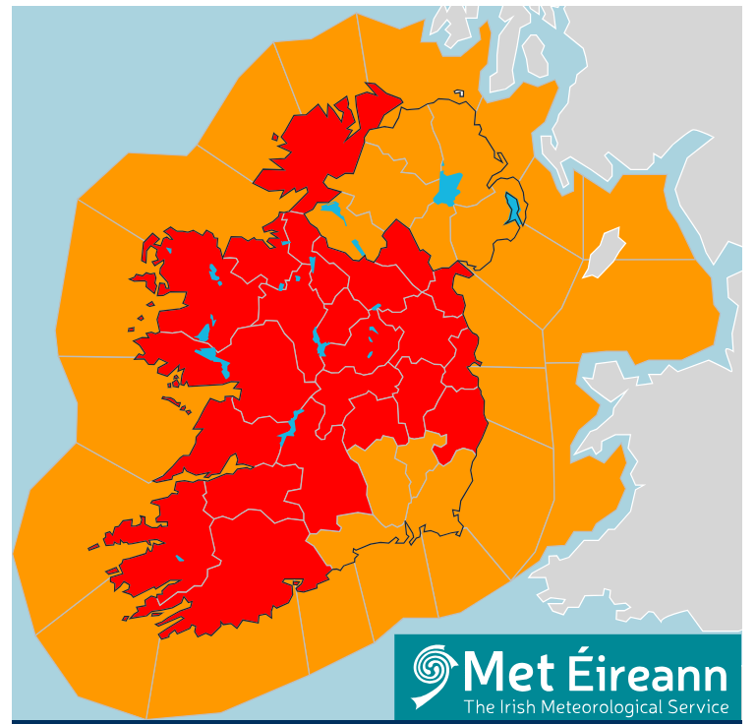
Storm Éowyn - Current Warnings
RED Warnings from 0200hrs Friday to 1500hrs Friday
(Expect to change)
Cork, Kerry & Limerick 0200hrs to 1000hrs
Clare & Galway 0300hrs to 1200hrs
Leitrim, Mayo & Sligo 0400hrs to 1200hrs
Donegal 0600hrs to 1500hrs
CN, MN, D, KE, LS, MH,
OY, WW, RN, & Tipp 0600hrs to 1200hrs
ORANGE Warning from 0200hrs Friday to 1700hrs Friday
All of Ireland

Slide 3
Expected Impacts
Expected Impacts
Not safe to travel. Stay Inside is the overriding safety message associated with this Storm
Extensive power outage
Impact to water supply
Impact to Communications (Mobile, Data, Telephony)
Injury due to impact from debris
Coastal Flooding
Localised Flooding
Public Transport will not be running
School closures
Infrastructure damage
Impact on road network
Significant amount of fallen trees
There may be longer term impacts into weekend and the following week (restoration of power, transport etc).

Slide 4
HSE Considerations
RED to ORANGE – do we resume service provision on a time phased basis?
Met Éireann – expectation is that winds will be very high Orange level gusting into RED. Risk associated with staff and service users moving in continuing storm conditions and on routes that may have been impacted/compromised.
Essential Services – preparations to ensure key staff in position –
accommodation, shift extension, potential supply issues, pharma, linen etc.
Plan for vulnerable service users – dialysis, end of life care etc.
Pre-Storm, bring in house or other staff arrangements
Cancellation of scheduled care / outpatient appointments / community based appointments– notifications to service users on media, social media and HSE.ie
In the face of such strong public safety messaging – focus should be on urgent/emergency service provision
Site/Facility preparation – check secondary power sources (generators), Secure loose materials on site (bins, Signs etc.)
Generators checked, fuel supply, Maintenance/Estates ensure they have upto date contact details for ESB/EIRGRID with facility details.
Potential impact on water supply – ensure on site water tanks are full & additional supply of drinking water is available. (if impacted it could be days before normal services are resumed)
Water tanks full on all sites, alternate drinking water supply
Regions need to engage with LOCAL COORDINATION GROUPS (they have been told to stand up from this afternoon) – HSE issues can be addressed at these groups. HSE Emergency Management will assist Line Managers with contact and engagement.
Regional Line Management through HSE Emergency Management to engage with LCC groupings – essential for the recovery
Construction – sites with on-going construction/building will need to ensure that sites are secured.
All Comms to public continue to include reference to include public safety messaging

Slide 5
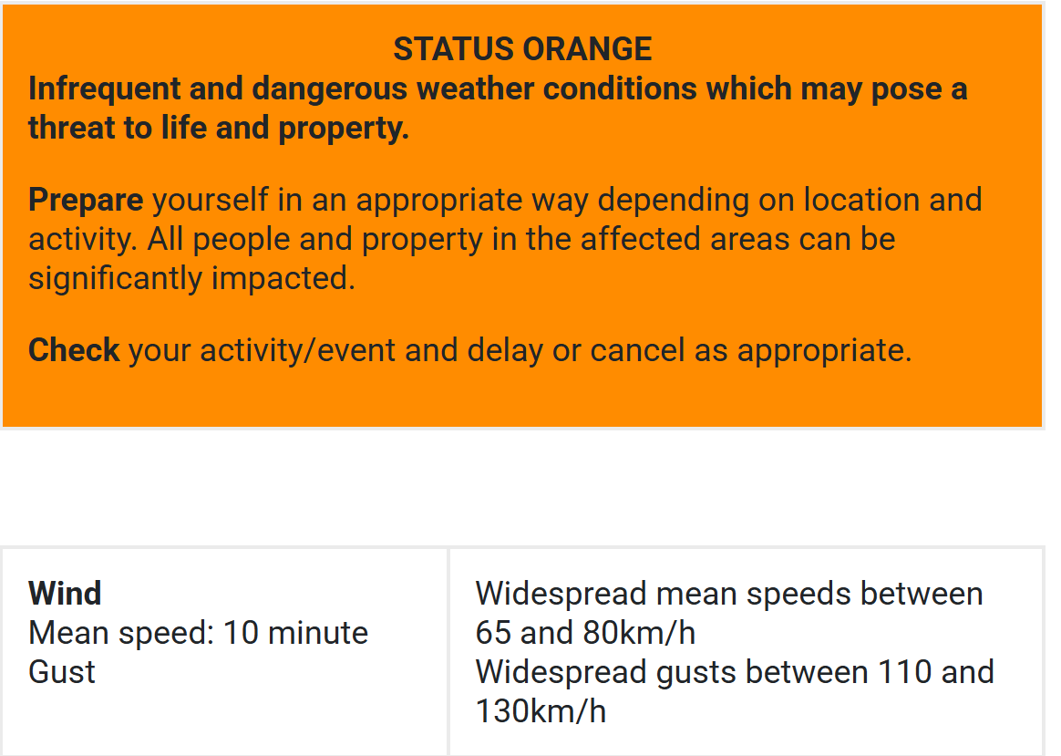
Orange Wind – Understanding

Slide 6
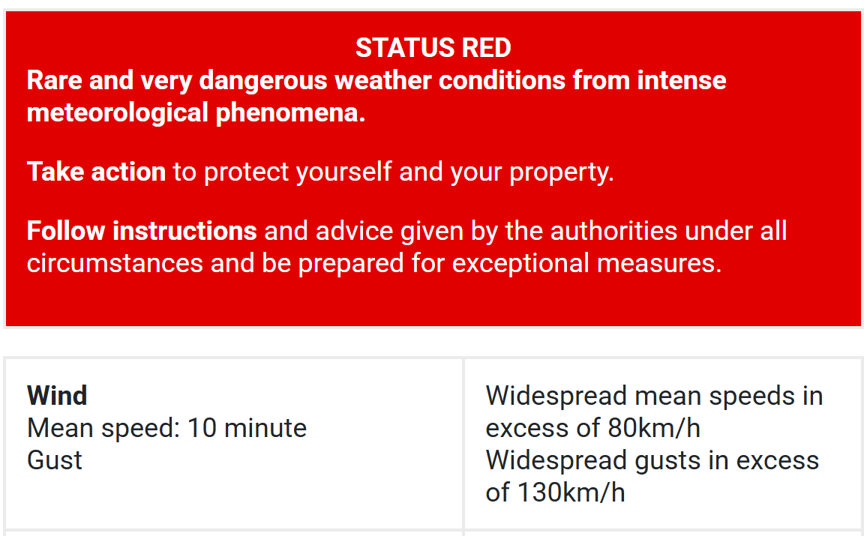
RED Wind – Understanding

