Slide 1
Data and HIQA’s role in Irish Health and Social Care
Kevin O’Carroll, Standards and Technology Manager
Health Information and Quality Authority
Notes:
Hello and good morning to everyone
Thanks to Loretto and Theresa for organising these webinars. I hope you all enjoy them and find them beneficial.
Briefly about myself, I’m the standards and technology manager in HIQA, been in the role quite a few years now. Currently I’m displaced in Tipperary since March 13^{th.}

Slide 2
Overview
HIQA and Health Information
Data Quality Team
Data Quality Framework
eLearning Modules
Technical Standards Team
IHI, Referrals, SNOMED CT.
Notes:
This is simply a brief overview of what I plan to talk to this morning.
My main objectives today are to explains HIQA role and functions with respect to health information and I will point you in the direction of some excellent resources we have published on our website.
I am going to focus on the data quality work led out by Barbara Foley
At the end I will give you a very brief overview of the work undertaken by the Technical Standards team focusing on how it helped in the response to the Covid-19 pandemic.

Slide 3
HIS Directorate
Health Information and Standards Directorate
HI Quality
National Care Experience Programme
HI Technical Standards
Health and Social Care Standards
Notes:
So, to set the scene, you will all be familiar with HIQA’s Regulation Directorate and it’s regulatory role in the area of residential facilities for older persons, disability centers and acute hospitals
We have other external facing Directorates in HIQA - one of which is the Health Information and Standards DirectorateOn screen is the organisational structure for our Directorate. We are divided into four teams with a workforce in the mid twenties.
Some of you will have come across the national care experience programme. The team have led out of the national inpatient experience survey which was conducted in 2018 and 2019. The survey is conducted in conjunction with the DoH and HSE. Unfortunately they had to cancel this years survey but I am happy to inform you that they have completed the first national maternity survey and results will be published later in the year.
The Health and social care standards team came into the health information directorate circa 2015, they develop standards such as the national standards for safer better healthcare and more recently the national standards for adult safe guarding and national standards for infection prevention and control in community services.
Then there are two ‘health information teams’ – the quality team and the technical standards team and it is the work of these teams I am going to focus on for the remainder of the presentation.

Slide 4
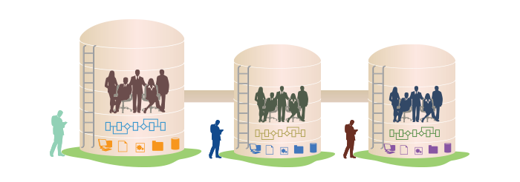
Health Information landscape
Notes:
Health and social care is information intensive, generating huge volumes of data every day. Health and social care workers spend a significant amount of their time handling information, collecting it, looking for it and storing it.
It is therefore very important that information is managed in the most effective way possible in order to ensure the delivery of high-quality safe services.
The Health Information teams work to improve the quality of data and information within the health and social care system.
We work collaboratively, using best available evidence, to develop recommendations to support decision making for the Irish eHealth and health information landscape.
We drive improvements in the quality of data and information by developing National Standards and Guidance and assessing compliance with these National Standards.

Slide 5
HI Quality team and the
Data Quality Framework
Notes:
The Quality team is a small team who focus on Data Quality, Information Governance and National Health Information Resources.
They have published Information Governance and Management Standards for National Health Information Resources and to date they have assessed the compliance of 4 national systems – Breast check, HIPE, PCRS and CIDR - with those standards.
Regarding Information Governance there are numerous publications on our website from the team including Guidance on Privacy Impact Assessment.
In addition they have undertaken a lot of work on Data Quality and I am going to focus on that aspect of their work.

Slide 6
Notes:
The Quality team have developed and published Guidance on a data quality framework for health and social care
The purpose of this document is to provide guidance on how to develop a data quality framework, in order to systematically assess, monitor, evaluate and improve the quality of your data and information.
The scope of this data quality framework is broad and covers the quality of both the data that is collected by organisations and information produced by organisations (such as statistics, indicators and analytical reports) using this data. This encompasses the entire data and information lifecycle.
The Guidance is divided into 2 parts. The first part of the guidance is the theory around the components of a DQF and the second part is the data quality assessment tool itself.

Slide 7
Methodology for development of guidance
Development of the guidance included a number of stages:
Review of international evidence
Expert Working Group
Specialist international expert advice
Targeted consultation.
Notes:
The development of the guidance included the following stages:
A review of international evidence, which has been published on the HIQA website – it covered data quality initiatives in Canada, Australia, South Africa, the NHS in UK and also references UN guidelines, OECD guidelines
Convening an Expert Working Group to advise them
Consulting with experts at the Canadian Institute for Health Information (CIHI). This stage was hugely beneficial in enabling the team to understand the most important aspects of data quality assessment and how a data quality framework might work in practice within the Irish context.
Undertaking a targeted consultation was also carried out in relation to the draft guidance over a four week period- 38 responses.

Slide 8
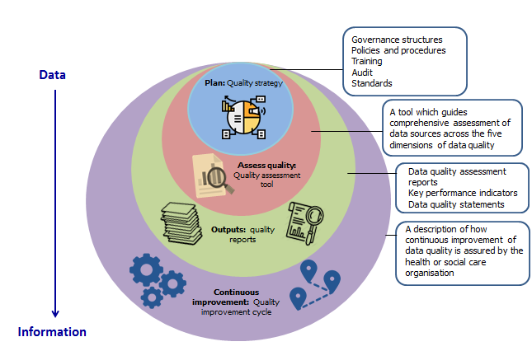
Data Quality Framework
Notes:
The components of a data quality framework include the following
a Data Quality strategy
a Data Quality assessment Tool
Reporting on data quality
A data quality improvement cycle
By assessing data quality it is possible to:
establish a baseline for data quality and identify any areas for improvement
assess the impact of any changes in practice, policies or procedures on data quality
report on improvements in data quality.

Slide 9
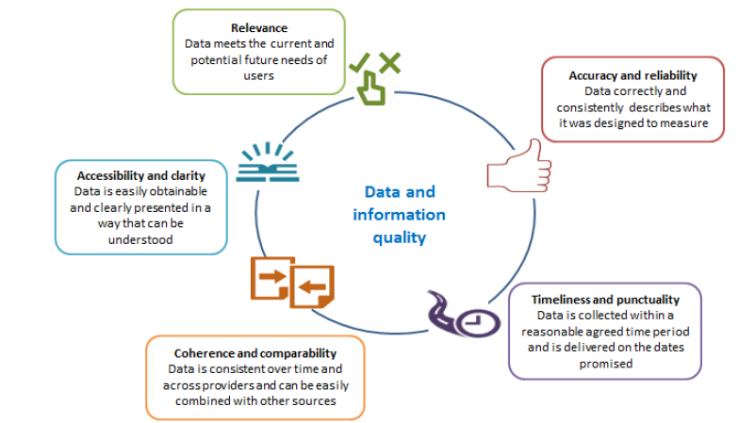
Dimensions of Data Quality
Notes:
The quality of data can be defined and assessed using the following internationally accepted dimensions:
Relevence: Relevant data meets the current and potential future needs of users.
Accuracy and Reliability: The accuracy of data refers to how closely the data correctly describes what it was designed to measure. Reliability refers to whether that data consistently measures, over time, the reality that it was designed to represent.
Timeliness and punctuality: Timely data is collected within a reasonable agreed time period after the activity that it measures. Punctuality refers to whether data are delivered or reported on the dates promised, advertised or announced.
Coherence and comparability: Coherent and comparable data is consistent over time and across providers and can be easily combined with other sources.
Accessibility and Clarity: Data is easily obtainable and clearly presented in a way that can be understood.

Slide 10
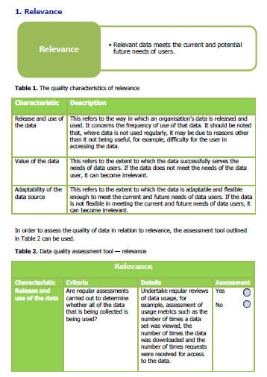
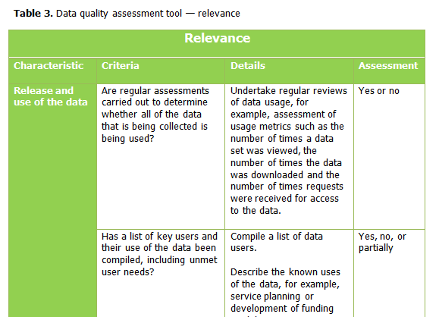
Data Quality Assessment Tool
Notes:
The assessment tool comprises five sections, each focusing on one key dimension of data quality.
Each section contains an introduction to the dimension, definitions/explanations of the quality characteristics of that dimension, examples of assessment of that dimension, and the assessment tool itself, where users can assess the quality of their data
The assessment tool has been developed as an interactive PDF also.

Slide 11
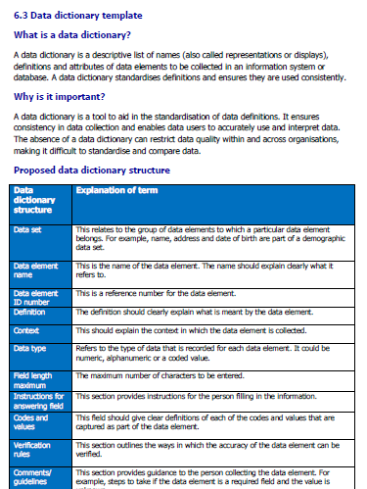
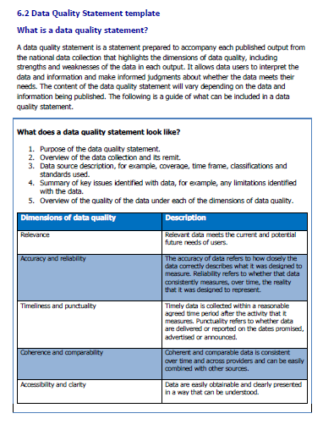
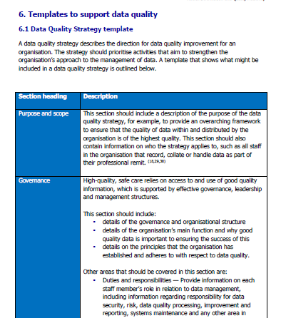
Templates to support data quality
Notes:
At the back of the Guidance, there are a number of templates which organisations can use to address various aspects of data quality practices…illustrated on the slied are templates for a data dictionary, a data quality statement and a data strategy template.

Slide 12
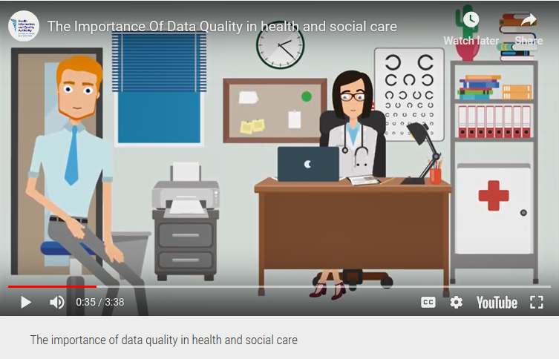
Data Quality Animations
Notes:
The HI Quality team have developed an animation which addresses the importance of good quality data in health and social care. It is an excellent introduction to data Quality and cover key concepts on data quality.

Slide 13
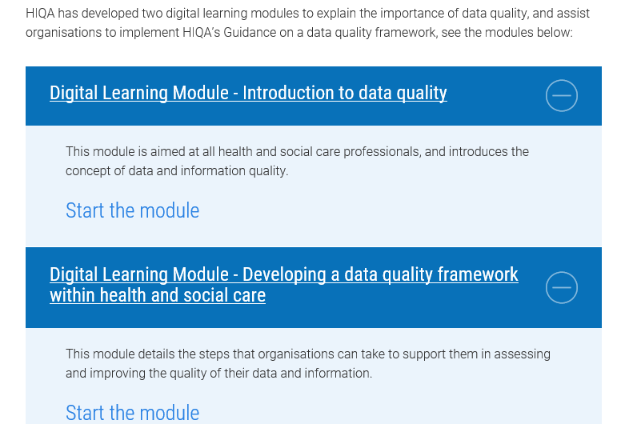
Supporting materials
Notes:
In addition to the animation and guide to data quality there are two eLearning modules available on the website – one of the links was broken yesterday when I was checking and I have ask out webmaster to resolve same.

Slide 14
HI Technical Standards team
Notes:
Now – my own team – we are more in the interoperability space and focus on trying to improve the quality of information shared across organisation boundaries during a patient care.
We are 4 in the team and we focus on Standards and Guidance for common business processes e.g. Referrals, Patient summaries, Discharge Summaries, electronic prescribing, Terminologies and Classifications, Information and Data Models

Slide 15
Previous work and Covid-19
Notes:
The collection and processing of health information and data plays a vital role in the response to COVID-19, and the pandemic has seen the further implementation and rollout of a number of our recommendations and national standards in areas such as GP referrals and contact tracing.
It was an interesting journey personally as I was one of the HIQA staff who was deployed to do contact tracing in April and May just gone and was a regular of the Covid tracker and could see further roll out of work undertaken – some of the work a long time ago,
In 2011, we published recommendations and a national standard for referral information. While this standard has been widely adopted by GPs when referring patients to outpatient departments, COVID-19 has seen further rollout of this standard as it was utilised in the systems implemented to allow GPs electronically refer people suspected of having COVID-19 to the testing centres nationally.

Slide 16
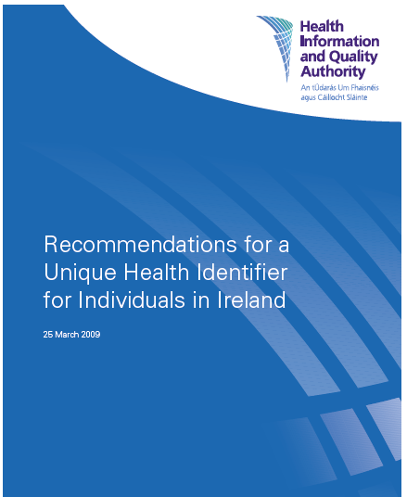
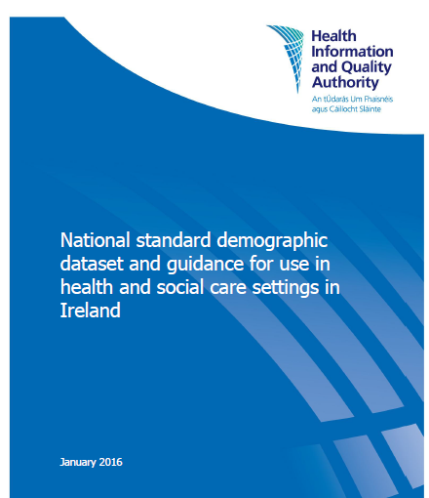
Previous work and Covid-19
Notes:
In 2009 HIQA published Recommendations on a Unique Health Identifier for Ireland which identified the need to a new health care focused identifier for Health and Social care in Ireland. Following this we would have undertaken further work which we would have fed in to the Department of Health to inform the Health Identifiers Act of 2014.
In addition, the 2016 National Standard for Demographic Dataset presented health and social care service providers with a standard core set of data elements to support the consistent, complete, and accurate recording of information for each service user.
It was an interesting experience to see the dataset being implemented in the covid-tracker demographics section and the IHI being populated for cases.

Slide 17
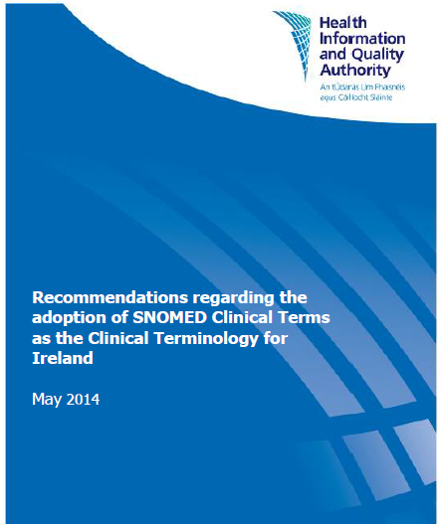
Previous work and Covid-19
Notes:
I chair the SNOMED CT Governance Group, which was established following HIQA recommendations in 2014 to the Minister for Health to implement the SNOMED CT international health information standards in Ireland. Following on from our recommendations, SNOMED CT was adopted as a national standard for Ireland and a National Release Centre was established within the HSE and managed by Theresa.
During the early stages of the pandemic, the National Release Centre collaborated with SNOMED International, and national and international stakeholders to develop and agree a data set for the assessment, testing, contact tracing and management on COVID-19 cases in Ireland underpinned by SNOMED CT. This dataset was approved by the SNOMED CT Governance Group in April 2020, and progress is being made to implement it in information systems that will support the management of COVID-19 in community and hospital settings.
It will improve data quality, allow for interoperability between information systems, allow for internationally comparable data and allow for good recording and retrieval data.
I wont say much more as I am aware that Theresa is going to talk to SNOMED later.

Slide 18
Thank you
technicalstandards@hiqa.ie

